Slide 1

Welcome to Hamble
Primary School
Tuesday 5th May 2026

Slide 2
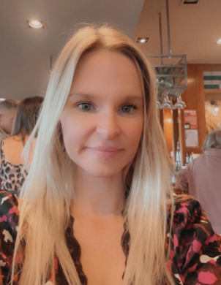
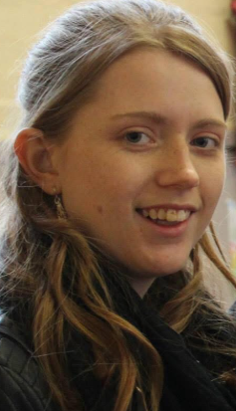
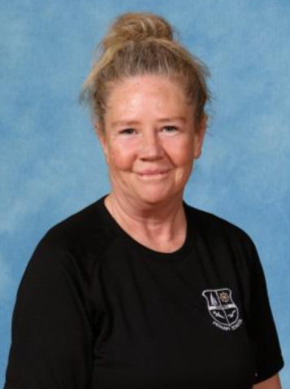
Meet the team
Miss Hall
Miss Churcher
Mrs Main

Slide 3

Our Vision
A sense of belonging
Every child is a unique child
An inspiring, challenging environment
Rich learning opportunities.
Provide a safe environment
Stimulating
resources

Slide 4


What is the Early Years Foundation Stage?
The Early Years Foundation Stage are the stages of education for children from birth to the end of the reception year.
It is based on the recognition that children learn best through play and active learning.

Slide 8
Within the theme of Learning and Development there are seven areas. All areas are connected to one another and are equally important.
Personal, Social and Emotional Development
Communication and Language
Physical Development
Literacy
Mathematics
Understanding the World
Expressive Arts and Design

Slide 9
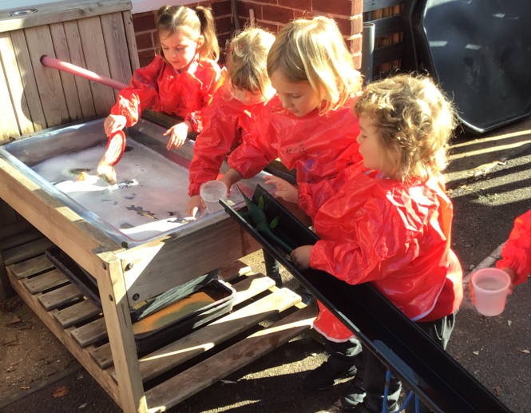
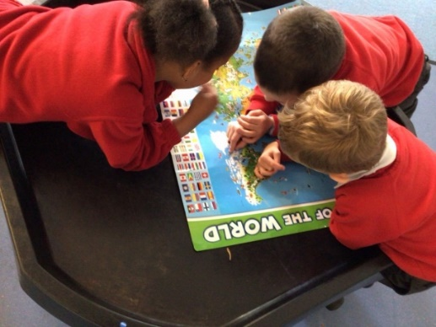
Personal, Social and Emotional Development
Being confident to speak to
others about own needs, opinions
and interests.
Initiating conversations.
Playing in a group and elaborating on ideas.
Being aware of boundaries and behavioural expectations within the setting.
Being confident to try new activities and show independence, resilience and perseverance in the face of a challenge.
Managing their own basic hygiene and personal needs, including dressing, going to the toilet and understanding the importance of healthy food choices.

Slide 10
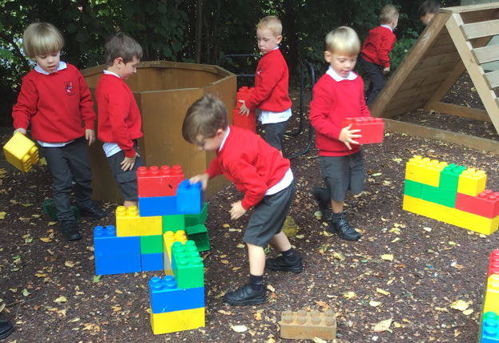
Communication and Language
Listening and responding to others.
Talking about why things
may happen.
Asking questions to deepen
their own knowledge.
Responding to instructions.
Expressing their own ideas and feelings about their experiences.

Slide 11
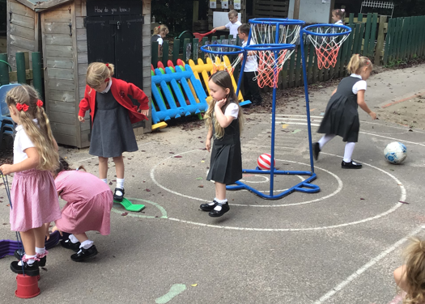
Physical Development
Experimenting different ways of moving.
Holding a pencil effectively in preparation for fluent writing.
Using a range of small tools, including scissors, paintbrushes and cutlery.
Negotiating space.
Demonstrating balance and coordination.

Slide 12
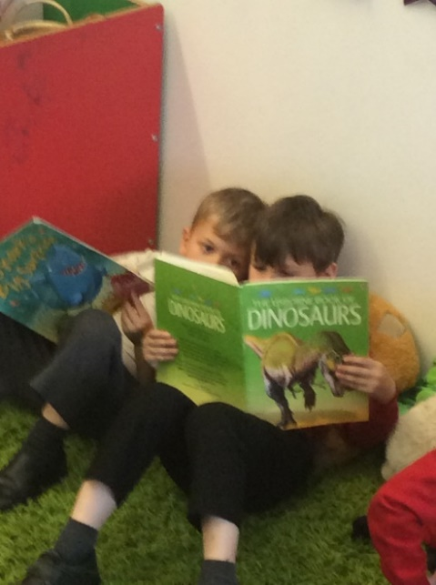
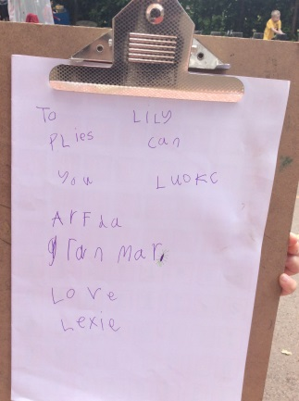
Literacy
Reading
Writing
Beginning to read words and sentences.
Writing recognisable
letters.
Enjoying a range of
books.
Writing meaningful
sentences.
Spelling words by
identifying sounds in
them and representing
the sounds with a letter
or letters.
Retelling and sharing
favourite
stories with friends.

Slide 13
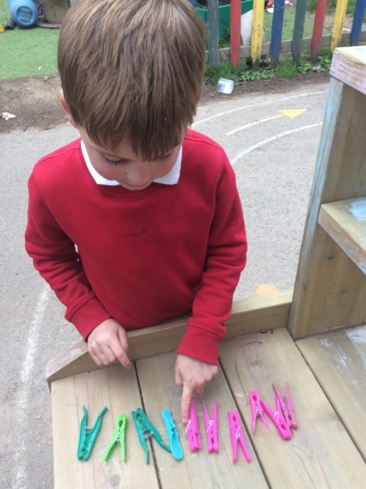
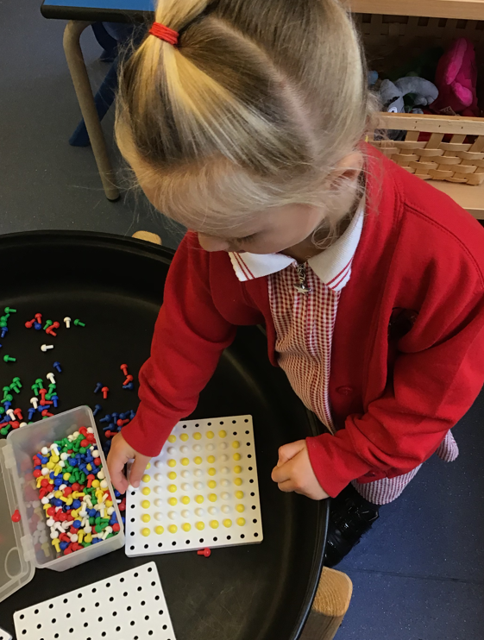
Mathematics
Having a deep understanding of number to 10,
including the composition of each number.
Exploring and representing patterns within numbers up to 10, including evens and odds, double facts and how quantities can be distributed equally.
Verbally counting beyond 20, recognising
the pattern of the counting system.

Slide 14
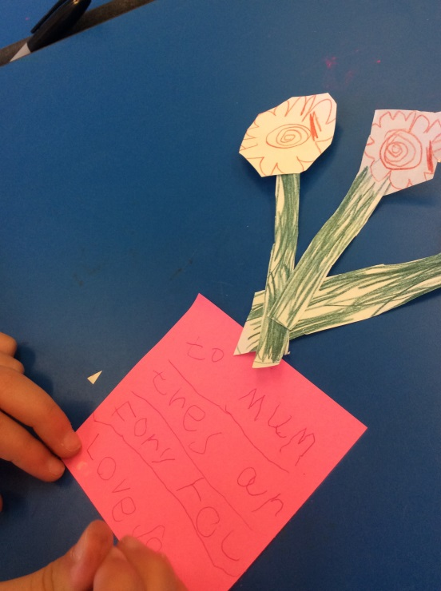
Understanding of the World
Talking about special events for family and friends.
Showing care and
concern about the
environment.
Enjoying
joining in with
family customs
and routines.
Exploring the natural world around them, making observations and drawing pictures of animals and plants.
Understanding the past through settings, characters and events encountered in books read in class and storytelling.

Slide 15
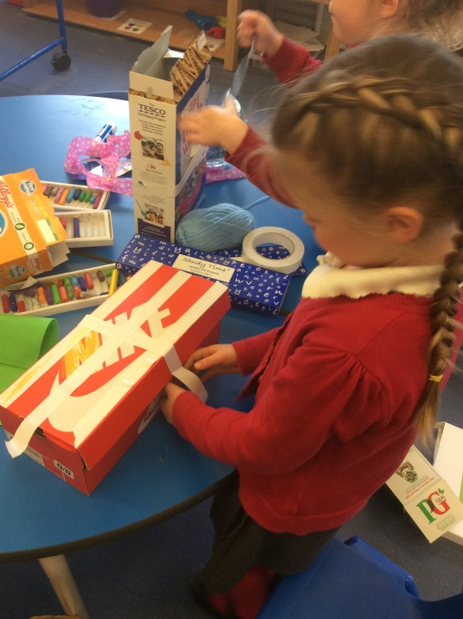
Expressive Arts and Design
Safely using and exploring a variety of materials, tools and techniques, experimenting with colour, design, texture, form and function.
Sharing their creations, explaining
the process they have used.
Singing a range of well-known nursery rhymes and songs.
Performing songs, rhymes, poems and stories with others.

Slide 16
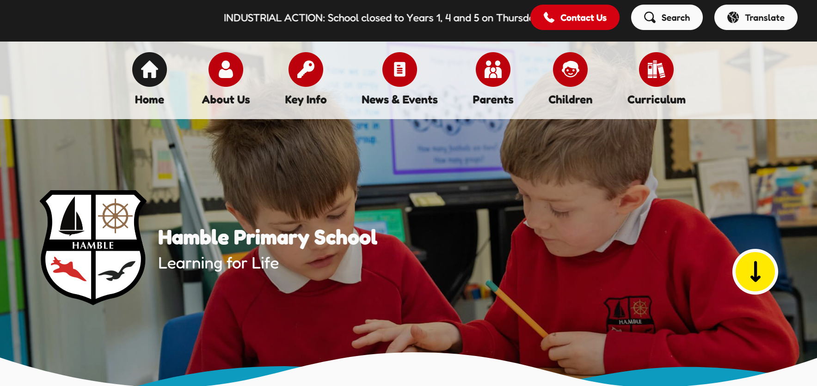
Curriculum Information

Slide 17
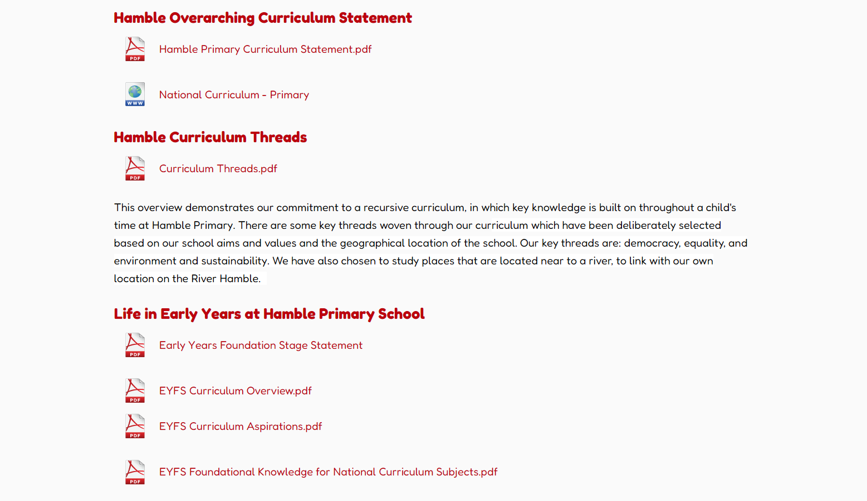
Curriculum and Policies

Slide 18

Curriculum and Policies

Slide 19
A Day in Year R at
Hamble Primary School…

Slide 20
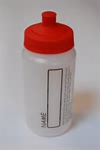





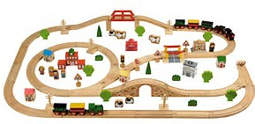
Early Morning Activities
When the children arrive in school they will put their things away and
then have the opportunity to explore a range of activities.

Slide 21

Talk Time
We have dedicated times for the children to simply talk as a
group, share ideas, feelings and any news.

Slide 22

Funky Fingers
In Funky Fingers, we provide opportunities for the children to
develop their gross and fine motor skills in preparation to become fluent
writers.

Slide 23
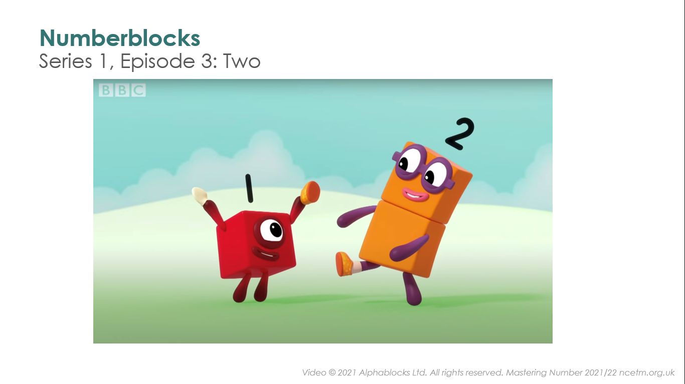
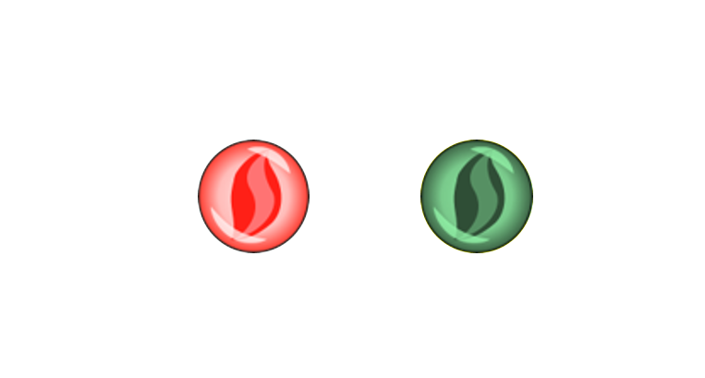
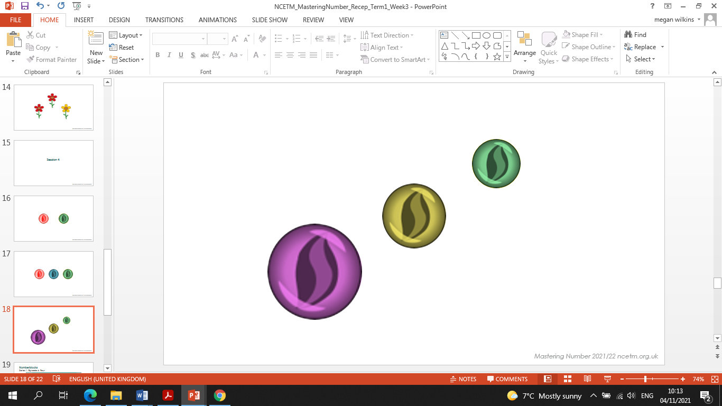
Maths Meeting
Recognition of numbers.
Children interacting and supporting each other by playing games.
Children learning and remember numbers by sight.

Slide 24

Phonics
Phonics is the recommended strategy through which children should be taught to learn to read.
As a school we use the complete phonics programme
Little Wandle Letters and Sounds Revised.
To help establish a love of reading:
- whole class reading sessions
- sharing stories

Slide 25
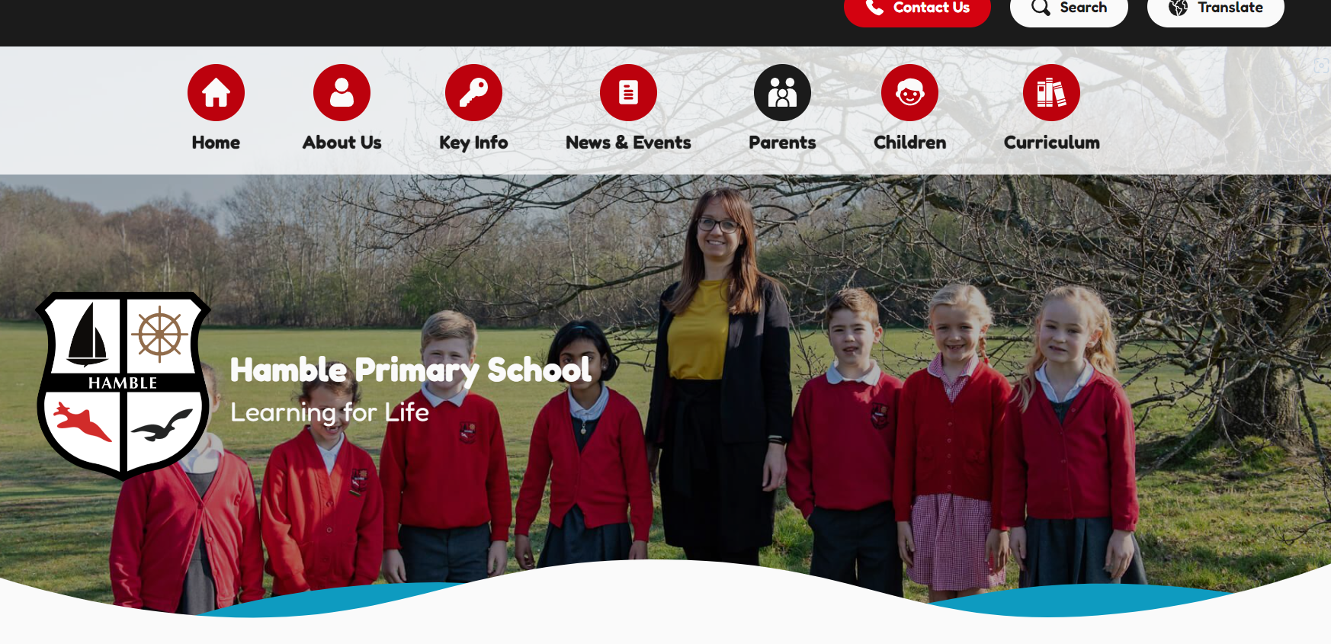
Phonics

Slide 26
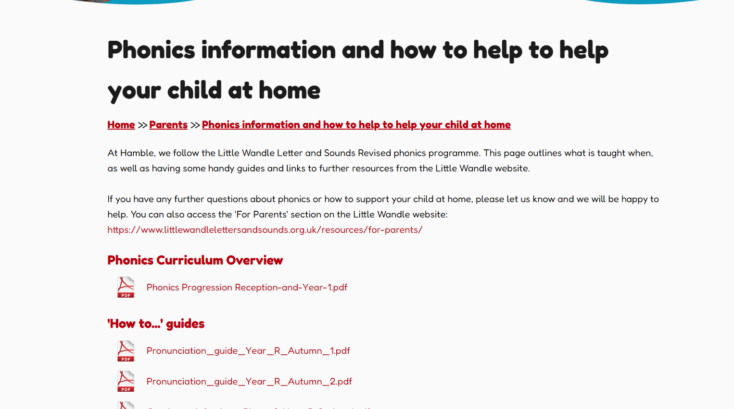
Phonics

Slide 27
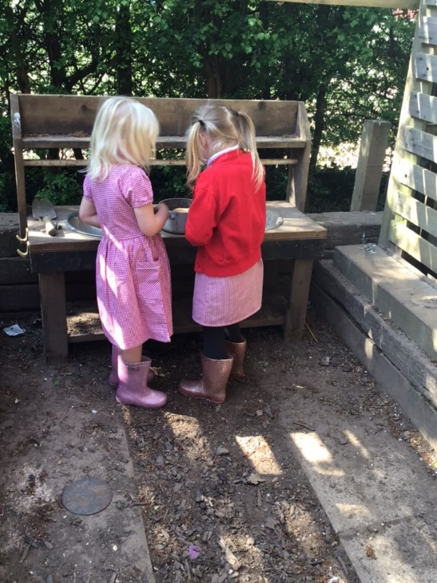
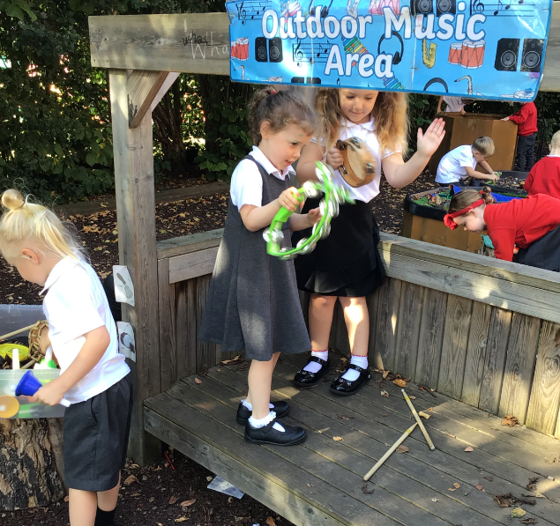
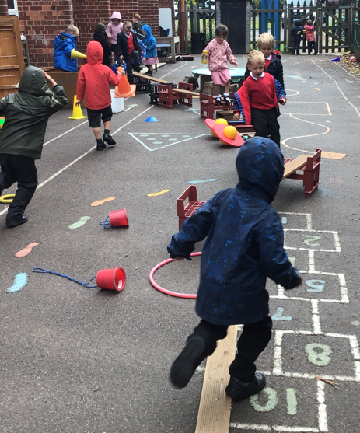
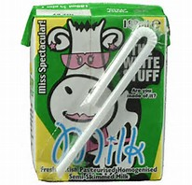

Busy Bee
The importance of play
Support
Motivate

Slide 28
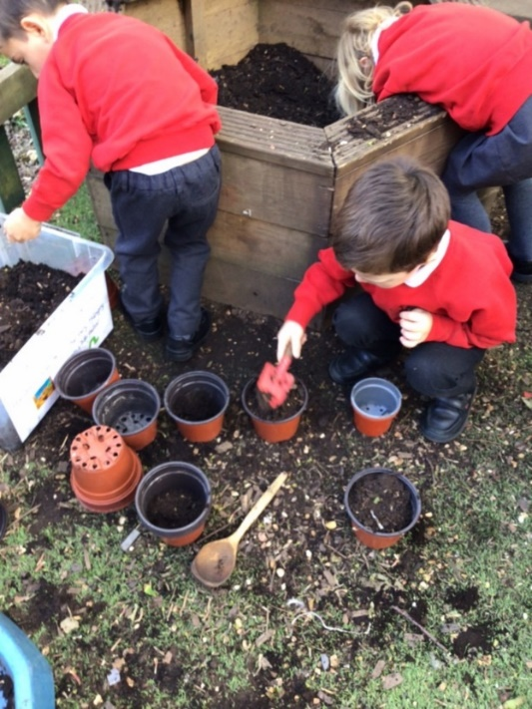
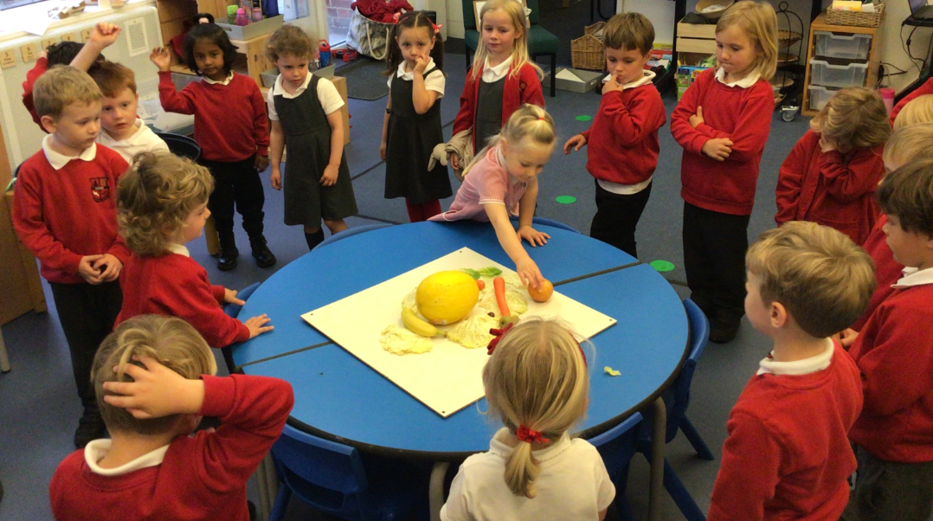
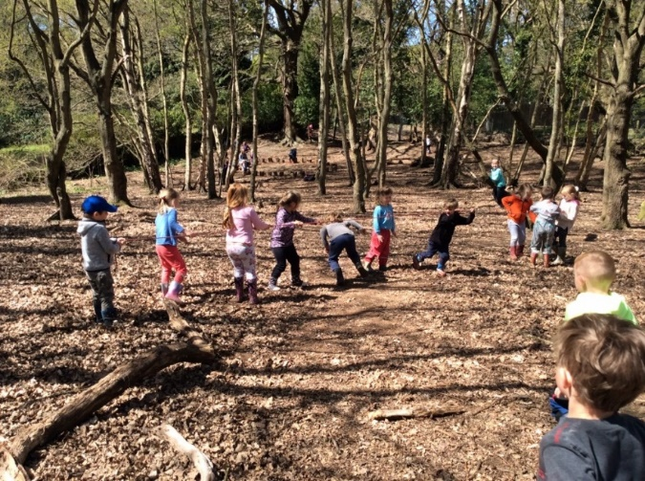
Busy Bee
Inspire
Encourage
Challenge

Slide 29
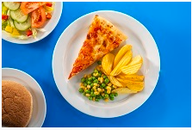
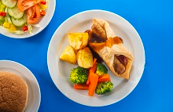
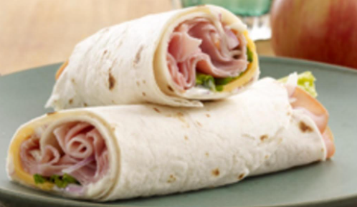
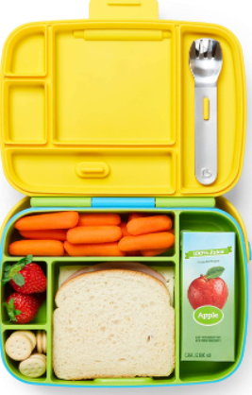
Lunch
Lunch choices:
Red (meat)
Green (vegetarian)
Blue (jacket potato)
Orange (pasta)
Yellow (bring their own lunch)
Please ensure if your child has any allergies or dietary needs, that you register this with Impact Food Group as soon as possible.
Nut free school

Slide 30

Google classroom
Google classroom is an online learning platform where we can share with you, ‘WOW’ moments.
We aim to work with you in partnership to ensure your child reaches their full potential.
We encourage your contributions from home, these can be made by yourselves and other family members.

Slide 31
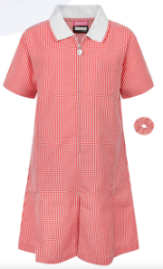



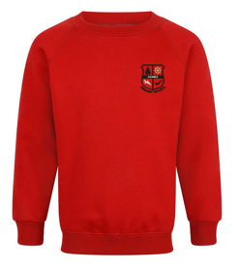

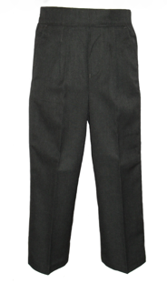
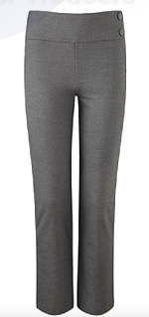
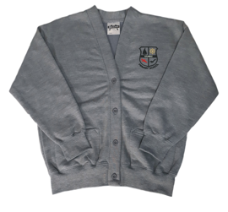

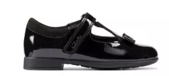
Uniform
None of our school uniform needs to carry the Hamble Primary School Logo.
Grey jumpers or cardigans are only for Year 6 pupils.
Please remember to name each piece of your child’s uniform. If any is lost it will usually come straight back to you if named!

Slide 32
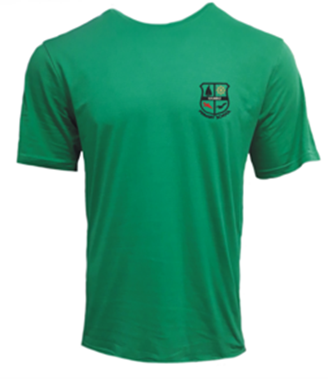
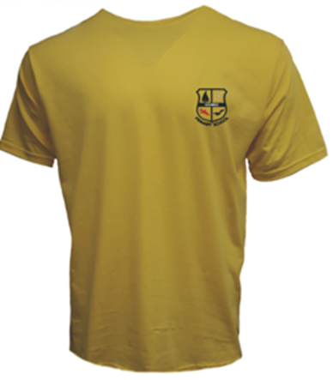



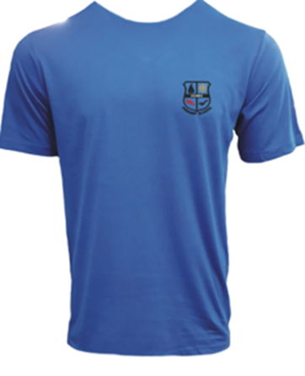


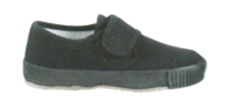
P.E Kit
Shakespeare
Curie
Each child is assigned a house.
Their P.E kit will need to be in their
house colour.
Beethoven
DaVinci

Slide 33
Additional items your child will need.
We will provide your child with a book bag; they will get these on their home visit.
P.E kit in on the first day of each term.
Fruit will be provided each day.
Named water bottle everyday.
Milk is an option – www.coolmilk.com

Slide 34
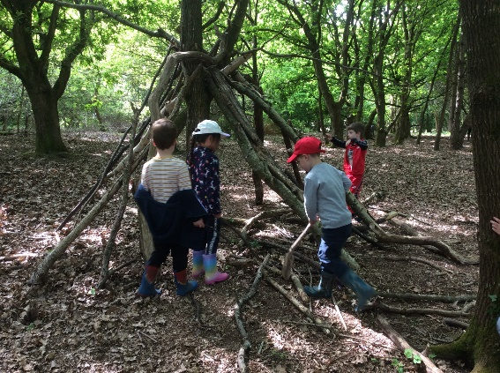
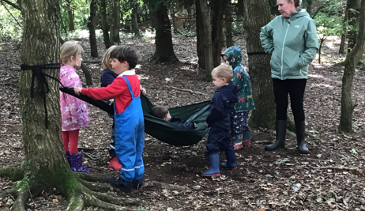
Outdoor Learning
Every Friday, we have ‘Forest Fridays’. This is our outdoor learning session.
They will need:
Wellies
Long-sleeved tops
Long trousers
Jumpers
Waterproof clothing- either an all in one or
separate trousers and coat.
Hat- suitable for the current weather.

Slide 35


Barnados have been commissioned to provide the school nursing service. They have three support options that are available to parents to explore ‘School readiness’
  A pre-recorded, non-interactive Webinar that parents can watch in their own time
  A one off, interactive "School Readiness" Workshop lasting 1½ hours which is bookable through Eventbrite
  A "School Readiness" Course, comprising of 4 weekly sessions, each lasting 1½ hours. Again, this is bookable through Eventbrite.
All these options are free and can be accessed via the Hampshire Healthy Families Website at https://www.hampshirehealthyfamilies.org.uk/school-readiness

Slide 36
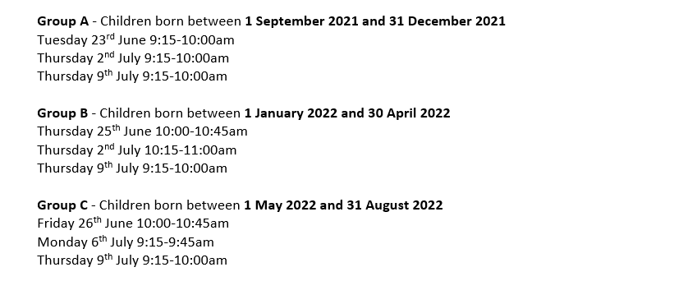
Thank you!

