Slide 1

Welcome to our year 3/4 shared learning

Slide 2

Supporting your child with Anxiety
With Mrs Foster
(ELSA and Parent Link Worker)

Slide 3
Welcome to Day 1
– Introductions
- Icebreaker (left and Right game)
- Comfort/stretch and panic zone
- Introduction to anxiety
- Fight/Flight/Freeze
- Signs of Anxiety
- Look after You!
– Ways to Support Your child
Building a Toolbox!
    Breathing Techniques
    Grounding techniques
    Muscle relaxation
    Mindfulness – describe object in as much detail as possible from the bag.
    Mind calming – A-Z of categories – Animals. Names. Things you like to eat etc

Slide 4
Welcome back to Day 2
- Triggers.
Facing our anxiety- what happens when we don’t ‘face’ our anxiety. Feeding our anxiety and can’t do mindset.
- What I can and cannot control
Unhelpful Thinking and challenging it
- CBT – situation-physical and emotional feelings/ Behaviour/actions
Step out of your anxiety circle
Emotional First Aid Kit

Slide 5

Coffee Morning Date to Remember!
Monday 7th October @ 9am
Autism Hampshire and No Limits
Will both be coming along to talk about their service and support.
Please come along and support this coffee morning. They are a fantastic opportunity to meet outside agencies and find out more about what they do. 😊

Slide 6
Welcome to our year 4 shared learning
Our aims for today –
Look at what the research says about reading and its importance
Understand the importance of fluency and how you can build this at home
Give hints and tips of how to get your child reading at home

Slide 7


Question: From a recent survey, what percentage of children aged between 8 to 18 said they read daily?
81%
55%
28%

Slide 8
Answer:
81%
55%
28%

Slide 9
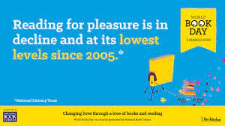
A survey by the National Literacy Trust early in 2023 has revealed that fewer than one in three children (28%) aged eight to 18 read daily for enjoyment.
While this remains the same as for 2022, the figure stood at 38% when the survey began in 2005, marking a 26% fall in those who read daily.

Slide 10
Why is there a decline in reading for pleasure?
Talk to one another about WHY you believe that reading for pleasure has declined.
Why do you choose not to read and do another activity?
What would you rather spend your time focusing on?
Mrs Matthews will take some ideas shortly

Slide 11
Why is there a decline in reading for pleasure?
Games and online distractions
Rise in social media
Find books boring
Lack of time
Not being read to from an early age by adults (at home and school)
Seeing reading as a process for learning rather a pleasure activity
  ‘Reading for pleasure' is being confused with 'literacy' by many parents at home who commonly don't realise that the more it's pushed as a school subject, the less likely a child is to choose to do it. In the school environment, the national curriculum focuses on reading skills above reading pleasure. However, when pleasure drives reading, children achieve more.

Slide 12
Question: If you read for a total of 20 minutes per day, how many words will you have read in a year?
1.8 Million
1 Million
250,000

Slide 13
Answer:
If you read for a total of 20 minutes per day, how many words will you have read in a year?
1.8 Million
1 Million
250,000

Slide 14
Impact of reading
Amount of reading per day | 20 mins | 5 mins | 1 min
Number of minutes per year | 3600 | 900 | 180
Number of words per year | 1.8 Million | 282,000 | 8000
Hours read by the end of primary school | 851 | 212 | 42
Performance on tests | 90% | 50% | 10%

Slide 15
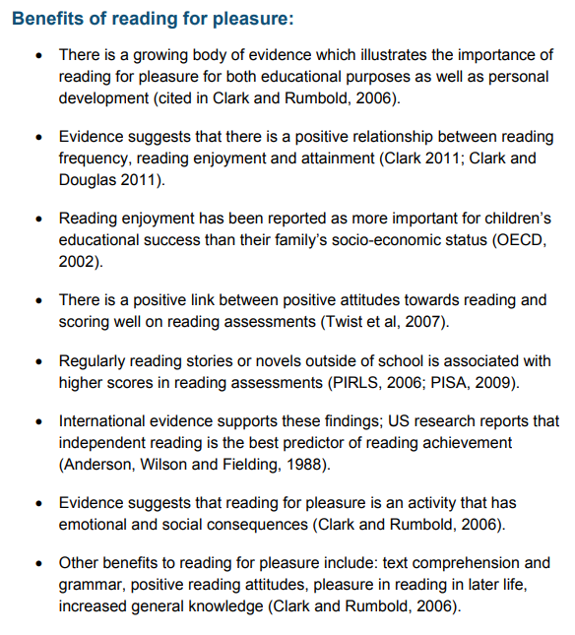
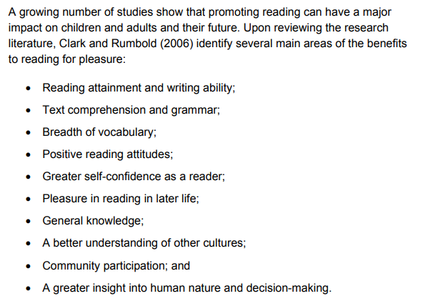




Slide 16
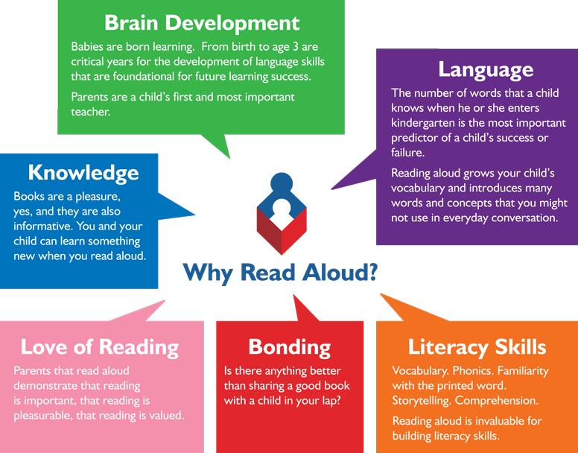
Reading from an early age and securing phonics
Reading from an early age is important as research shows that if children are not secure and fluent readers by Year 2, it is very difficult to then develop a love of reading going forward.
In order to get children fluent in reading, their phonic knowledge must be embedded within EYFS and KS1.
Read to children from day zero!

Slide 17
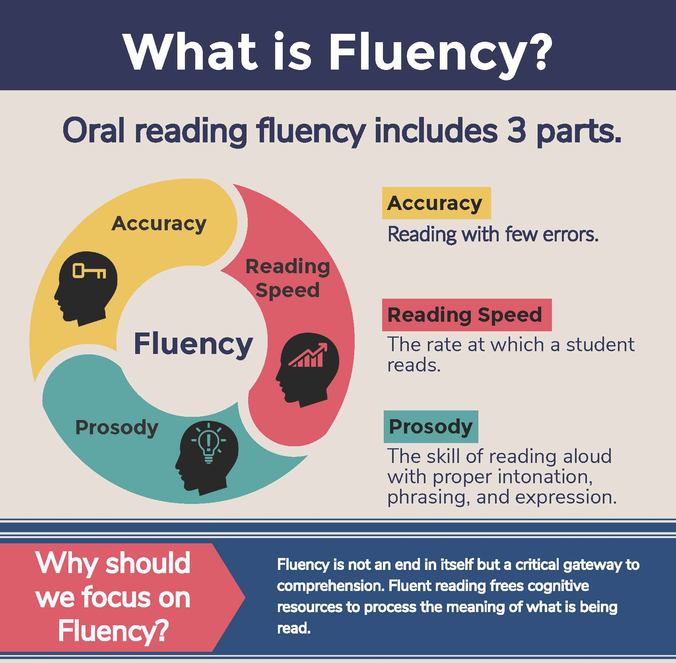
What is fluency and why is it important?
Fluent reading supports reading comprehension. When pupils read fluently, their cognitive resources can be redirected from focusing on decoding and onto comprehending the text. For this reason, fluency is sometimes described as a bridge from word recognition to comprehension.
Basically, if the brain’s processing power isn’t being used up by working out how to read a word, it can concentrate on understanding and enjoying the text.

Slide 18
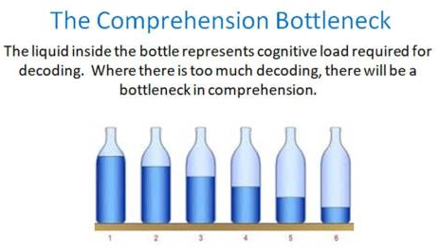
What is fluency and why is it important?
For a child to be fluent, phonic knowledge is important.
When a child is fluent, we can focus on understanding and comprehension.
When comprehension is secure, the child will enjoy what they read.
Secure phonics and fluency all reduce cognitive load.

Slide 19
Three ways you can help build fluency at home…
Read and follow
Shared Reading
Echo Reading
Independent Reading
Let’s have a go!

Slide 20
1. Read and Follow
The adult reads the text and the child follows along with their finger.
This helps the child with word recognition and models to them how they should read with fluency.
Try with just reading a paragraph or section to begin with.

Slide 21
2. Shared Reading
(also known as my turn, your turn)
Take turns reading a page or a paragraph.
Here the adult begins as you are modelling how to read with fluency, flow and expression.
Then the child takes over – once again this could be paragraph or a page.

Slide 22
3. Echo Reading
The adult reads and the child copies.
It is important here to pace yourself and read at a rate that your child can keep up with.

Slide 23
4. Independent Reading
The child reads alone or aloud to an adult but with independence.

Slide 24
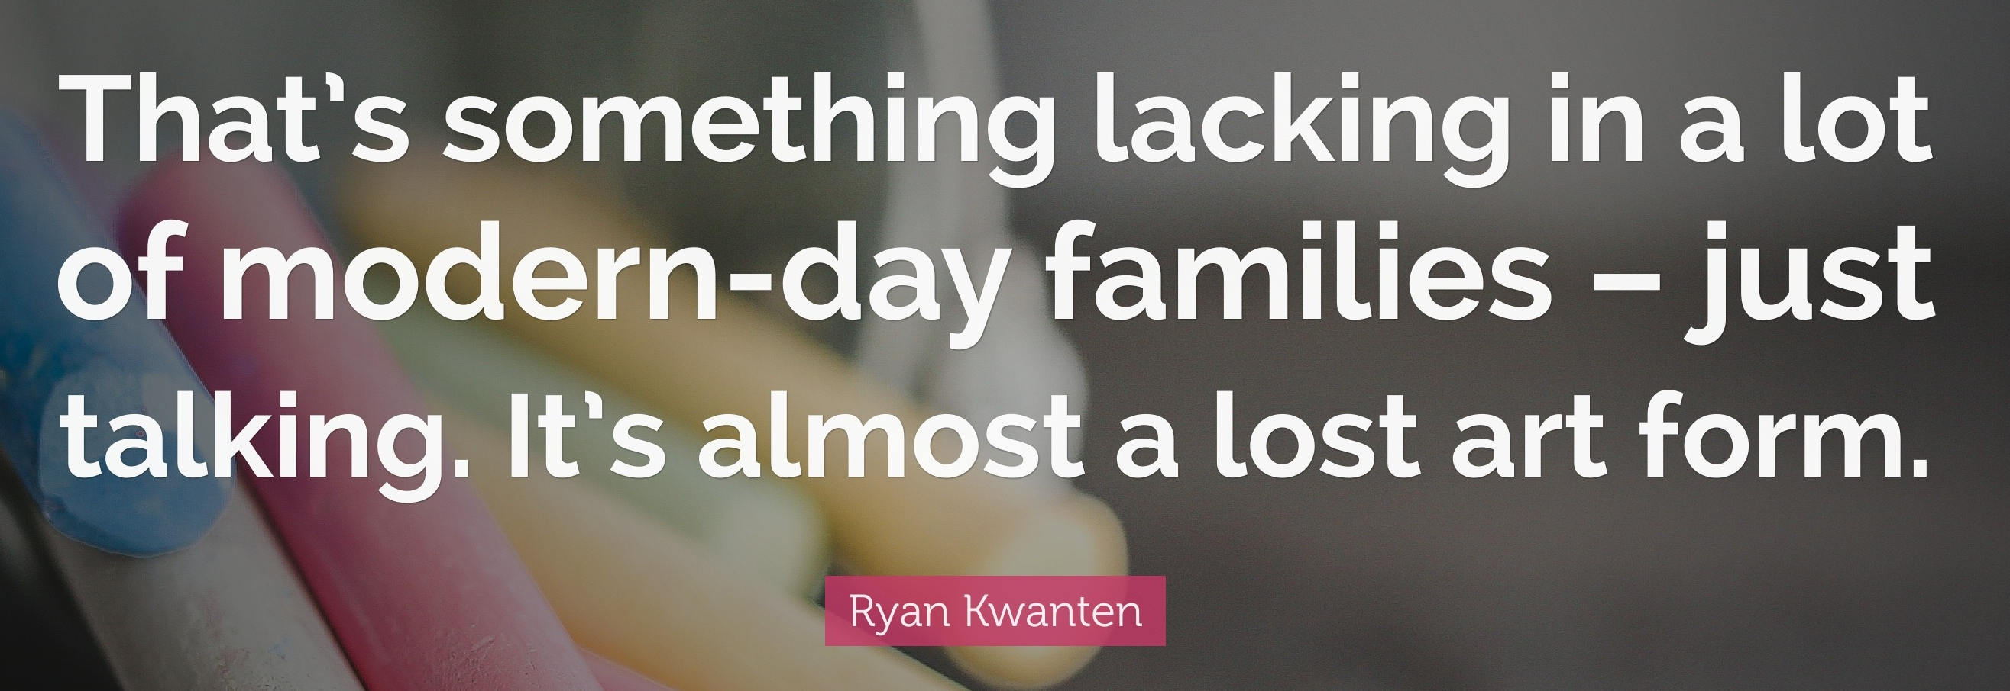
What you can do to help develop comprehension…
Comprehension of the world will develop comprehension in reading…
Ways you can develop comprehension –
  Talking a lot at home… about everything
  Develop cultural capital by going out (this does not have to cost money)
  Reading together and discussing books together
    Why do you like this book?
    What do you think will happen next?
    What do you think about this character?

Slide 25
How do we teach comprehension in school?
A more formal process…

Slide 26
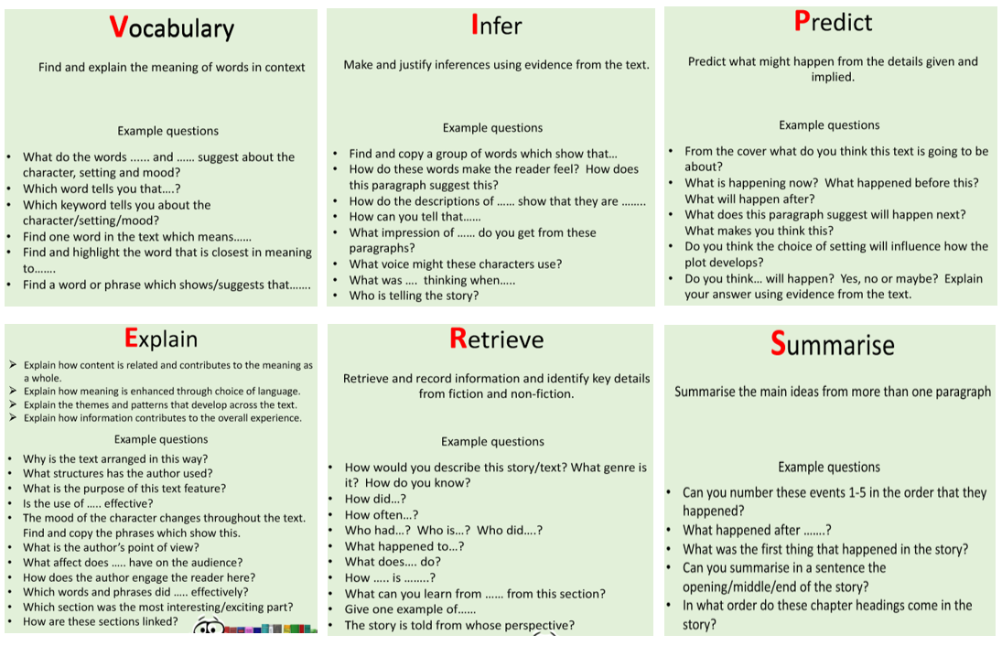
Questions you can ask at home… you can use the same model we have looked at today for this.

Slide 27
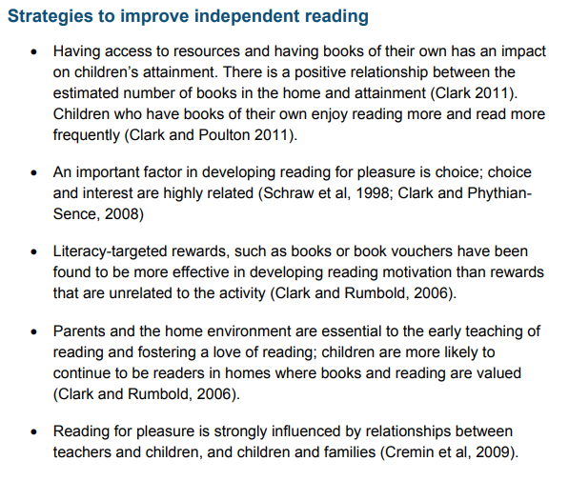
How to encourage independent reading at home
Having books that the child owns
Using the library to help build variety
Exposing children to texts beyond novel. E.g. comics, magazines, non-fiction books
Taking control of screens – reading first and then screentime
Show that you love reading… even if you have to fake it
Give children books that matter to them (BAME authors and characters, texts that excite them
Reward reading through extrinsic and intrinsic motivators

Slide 28
Question:
Which of the ways at home will you try ?
A. Read & Follow
B. Shared Reading
C. Echo Reading
D. All of them

Slide 29


