Slide 1
Virtual Meetings
Please put your name and your child’s first name and year group in the chat bar.
If you have any questions please write them in the chat bar and we will answer as many of these as possible at the end of the session. If we have questions outstanding, we will do a FAQ page and send this out.
Due to Zoom timing restraints, this meeting will cut off after 40 minutes.
Early Reading Workshop

Slide 2
Reading at Hamble Primary School
Reading is a vitally important part of a child’s development and is a key life skill. At Hamble Primary School we believe that every child can learn to read with the right help and support, and we endeavour to instil a love of reading within all children. We place reading and books at the centre of our English curriculum as well as using books as a stimulus and to support learning across the wider curriculum.
Notes:
Reading statement

Slide 3
Phonics – Where it all started!

Slide 4
Phonics is the recommended strategy through which children should be taught to learn to read.
As a school we use the complete systematic synthetic phonics programme Little Wandle Letters and Sounds Revised.
There are 5 phases in Little Wandle Letters and
Sounds .
It runs alongside other teaching methods such as whole class reading sessions and sharing stories to help children develop vital skills and give them a real love of reading.
Notes:
LWLSR is one of the phonics schemes approved by the DFE.
Phonics is a whole school approach- not just Year R.

Slide 5
Key Vocabulary
Phoneme – A unit of sound.
Grapheme – The way a phoneme is represented in writing.
GPC - Grapheme to Phoneme Correspondence: the individual letters or letters strings which represent individual sounds in the language, i.e. the way a letter ‘sounds’ when it is read aloud.
Segment – The breaking up of a word into the individual phonemes that it consists of, e.g. ‘sit’ = /s/ /i/ /t/
Blend – The joining of phonemes when they are said aloud, to form a word.
Rhyme – When the end syllable of two words makes the same sound, the word rhyme.
Syllable – A unit of pronunciation that has one vowel sound, with or without surrounding consonants.
Notes:
Phoneme is the sound it makes
Grapheme is the way it looks in writing.

Slide 6
Digraph – 2 letters that make 1 sound, e.g. /ch/ or /ay/
Trigraph – 3 letters that make 1 sound, e.g. /igh/
Split Vowel Digraph – when a vowel digraph (e.g. /oe/) is divided by a consonant, e.g. in the word ‘home’.
Tricky words (previously ‘sight words’) - Words that have a part that cannot be read using phonics, e.g. to, me, come. These are taught as part of phonics sessions.
Prefix – A unit of meaning added to the start of a root word, e.g. un-, dis-, re-.
Suffix – A unit of meaning added to the end of a root word, e.g. –ing, -ness, -ly.

Slide 7
Phase 3
Digraphs and trigraphs
Blending for reading
Segmentation for spelling
Tricky words
For parents | Letters and Sounds (littlewandlelettersandsounds.org.uk)
Notes:
Year R- once developed GPC and confidently segmenting and blending phase 2
Recapped at beginning of Year One for consolidation

Slide 8
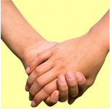
Digraphs
Trigraphs
igh light ear hear air fair
ai rain
th them
sh fish

Slide 9
Sound buttons
Segmenting e.g. s a t
Blending

Slide 10
Phase 4
Consolidate phase 3 phonemes
Blending using adjacent consonants.
screen, frog, soft, bench
Polysyllabic words (words with more than one syllable)
Tricky words
Notes:
Year 1
We have underlined it to show you where they are but they are separate sounds

Slide 11
Phase 5
Alternative graphemes
Selecting graphemes for spelling
Tricky words
Increased fluency
For parents | Letters and Sounds (littlewandlelettersandsounds.org.uk)
Notes:
Year one

Slide 12
a ai ay a_e
e ee ea e_e ey y
i igh ie i_e y

Slide 14
Year 2
Reading longer, unfamiliar texts independently
Reading for meaning
Rules for meaning are taught, e.g. plurals indicating more than one, how words are written in the past tense, and how prefixes and suffixes change the meaning of words
Phonics sessions focus more on using rules for writing, as children should be decoding fluently
Common exception words (reading then spelling)

Slide 15
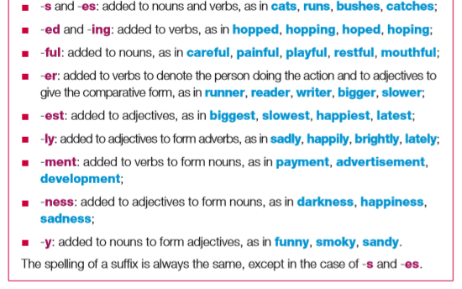
Suffixes
These are some of the suffixes taught as part of the
Year 2 curriculum:

Slide 16
“It must always be remembered that phonics is a step up to word recognition.”

Slide 17
Early Reading

Slide 18
Fluency
Automatic word recognition
Rhythm and phrasing
Expression

Slide 19
Vocabulary
Wide range of texts
Discussing meaning of words- encouraging children to ask!
Checking understanding and clarifying meaning

Slide 20
Comprehension
Book talk
Re-telling of the story in own words
Answer questions about the book
- Who is the main character/ how are they feeling?
- What happened at the
beginning/middle/end of story?
Book predictions
Fiction or non-fiction?
Notes:
How do you know?- Justify!!!!!!!!!!!!

Slide 21
Reading aloud
Why do we re-read texts several times?
Decoding
Prosody
Comprehension
For parents | Letters and Sounds (littlewandlelettersandsounds.org.uk)
Notes:
How do you know?- Justify!!!!!!!!!!!!

Slide 22
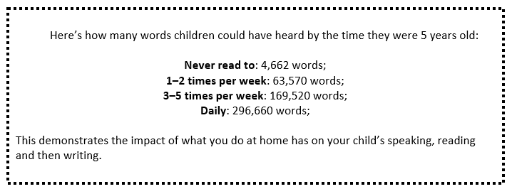
How you can help at home
Regular reading is key!!!!!
Notes:
Evidence suggests that reading for pleasure leads to increased attainment. Clark and DeZoya (2011) found a significant positive relationship between enjoyment and attainment indicating that pupils who read more are also better readers.

Slide 23
Thank you! Any questions?

