Slide 1
Reading and Writing in Upper Key Stage 2
Virtual Meetings
Please put your name and your child’s first name and year group in the chat bar.
If you have any questions please write them in the chat bar and we will answer as many of these as possible at the end of the session. If we have questions outstanding, we will do a FAQ page and send this out.
Due to Zoom timing restraints, this meeting will cut off after 40 minutes.

Slide 2
Reading at Hamble Primary School
Reading is a vitally important part of a child’s development and is a key life skill. At Hamble Primary School we believe that every child can learn to read with the right help and support, and we endeavour to instill a love of reading within all children. We place reading and books at the centre of our English curriculum, as well as, using books as a stimulus and to support learning across the wider curriculum.
Notes:
Reading statement

Slide 3
Phonics – Where it all started!

Slide 4
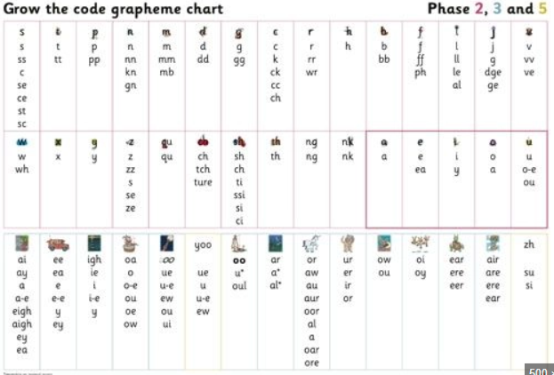
Phonics is the recommended strategy through which children should be taught to learn to read.
There are some children in Year 5 and 6 for which phonics is still a core part of their reading and writing. Therefore, there are phonics based supports and resources still provided in classrooms and by staff.
Please remember that this is also helpful for all children, as this is how they originally learnt to read.
This is also particularly helpful when supporting children with their spelling and a ‘Grow the Code’ chart is visible in every classroom.
You can find more information about phonics
on our website –
Parents – ‘Phonics information and how to
help your child at home.’
Notes:
LWLSR is one of the phonics schemes approved by the DFE.
Phonics is a whole school approach- not just Year R.

Slide 5
So, how is our journey mapped out?
In a typical 6 week half, the children’s learning would look like this…
Week 1 | Week 2 | Week 3 | Week 4 | Week 5 | Week 6
Narrative Week – a text linked to our upcoming theme is used to teach the vocabulary needed and revisit several reading skills. | Theme Week – As a school, we use this week to immerse the children in their Theme learning to ensure complete foundation learning and can use this to support reading and writing later in the term. | Theme Writing Week – The children use what they have learnt in their Theme Week to complete a piece of writing. | Writing – The teaching of grammar and writing elements to support a further written piece- based on a linked text. | Writing - | Writing -
 |  | Fluency – A speaking and language unit to support fluency and prosody within reading. | Reading – based unit based on a parallel text. | Reading – based unit based on a parallel text. | Reading – based unit based on a parallel text.
Notes:
The reason that this is a ‘Narrative’ week is because this is where we find children are most successful – this is also heavy throughout other units.

Slide 6
Reading Fluency
To build on the children’s previous phonics learning and support their ability to read ‘well’ we have half-termly ‘fluency’ units.
Fluency is the ability to read with speed, accuracy and with proper expression (prosody).
What parents can do to help at home:
Support and encourage your child. Realize that he or she is likely frustrated by reading if this is something they struggle with.
If your child can decode words well, help him or her build speed and accuracy by:
Reading aloud and having your child match their voice to yours (paired reading)
Having your child practice reading the same list of words, phrase, or short passages several times – we promote 3 reads at Hamble.
Reminding your child to pause between sentences and phrases.
Read aloud to your child to provide an example of how fluent reading sounds.
Give your child books with predictable vocabulary and clear rhythmic patterns so the child can "hear" the sound of fluent reading as he or she reads the book aloud.
Use Audiobooks; have your child follow along in the print copy or just listen for experience.

Slide 7
Reading Fluency
Notes:
EEF blog: Shining a spotlight on reading fluency

Slide 8
So, how do Reading sessions work?

Slide 9
Reading
The skills are as follows: However, the children should find that this is retrieval and inference based.
Retrieval: Getting basic information from a text.
Inference: Using evidence from the text to reach a conclusion.
Vocabulary: Using what you already know to work out the meaning of unknown words.
Themes and Conventions: Using the way that a text is written or presented to work out the message or purpose of a text. (This also helps us to write our own sometimes!)
Skimming and Scanning: Using the layout of a text to quickly skim to get an overall picture (getting the gist) or scan to quickly find an answer.
Authorial Intent: Thinking carefully about an Author’s choices with regard to vocabulary, presentation or features used. We talk a lot here about how this impacts the reader and how to be most effective when writing.
Visualisation: Thinking about the picture that is built within a narrative and how this helps the reader to understand the text. Again, this is used a lot in our narrative writing.
Monitoring and Clarifying – This is used to ensure that children understand what is happening throughout a whole text. This could be following the events, movements of a character or understanding a non-fiction thoroughly.
This is also something that can be carried through to your reading at home with the children. You should find support for this on our website: Parents – ‘Reading Newsletters’

Slide 10
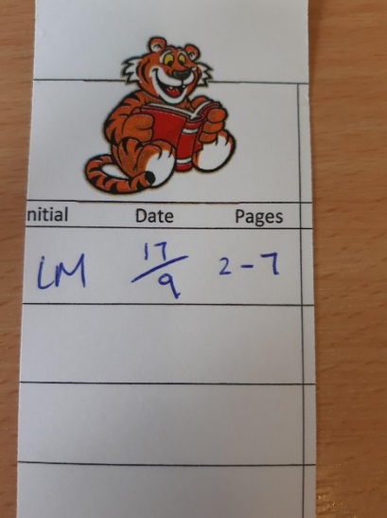
Reading at home
Our Library | SORA E-Library/ BigCat books | Reading Passport
All classes visit the library once per week where they can change and choose their own book. The teachers will keep an eye on what the children choose but the children are free to choose. This is having a bit of an update and we’re introducing ‘Junior Librarians.’ | SORA E-Library is and app/website that we have signed up to as a school where children can access E-Books and Audio Books. Your child should be able to log in via their Google Classroom log-in. This can be found on Parentmail. Big Cat may be necessary for some children and this has a separate log-in. You should already know if this is relevant for your child. https://soraapp.com/home | Please continue to record any reading done at home on your child’s reading bookmark.

Slide 11
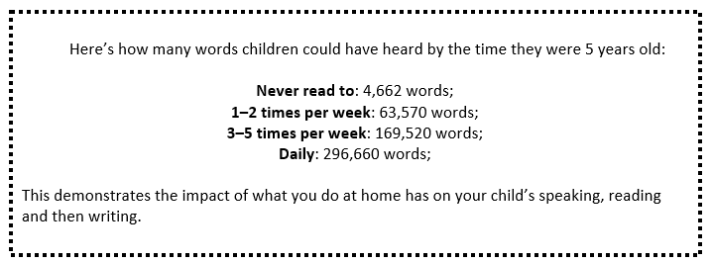
How you can help at home
Regular reading is key!!!!!
Notes:
Evidence suggests that reading for pleasure leads to increased attainment. Clark and DeZoya (2011) found a significant positive relationship between enjoyment and attainment indicating that pupils who read more are also better readers.

Slide 12
What do we mean by ‘Word Study’?
Etymology – the history of the word
Morphology – parts of the words that have meaning
Phonology/Orthography – how the word sounds/spelling rules
E.g. Recycling
Re cycle ing
again ‘circle, wheel’ present continuous verb

Slide 13
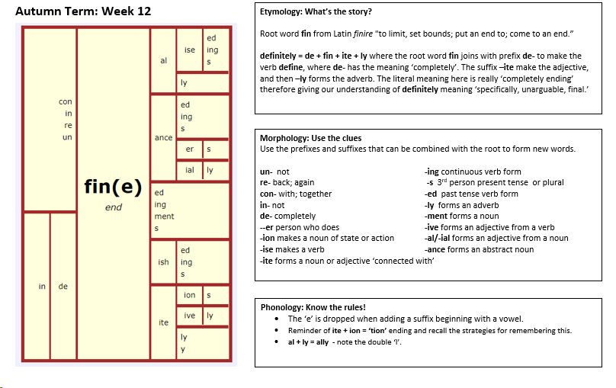
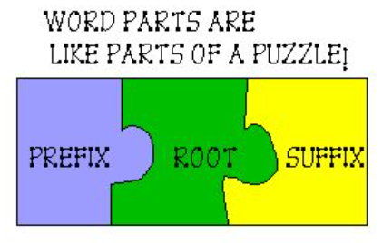
Word Study
Notes:
Hampshire advocated approach – helping children to build knowledge of words and adapt this and rules to other words.

Slide 14
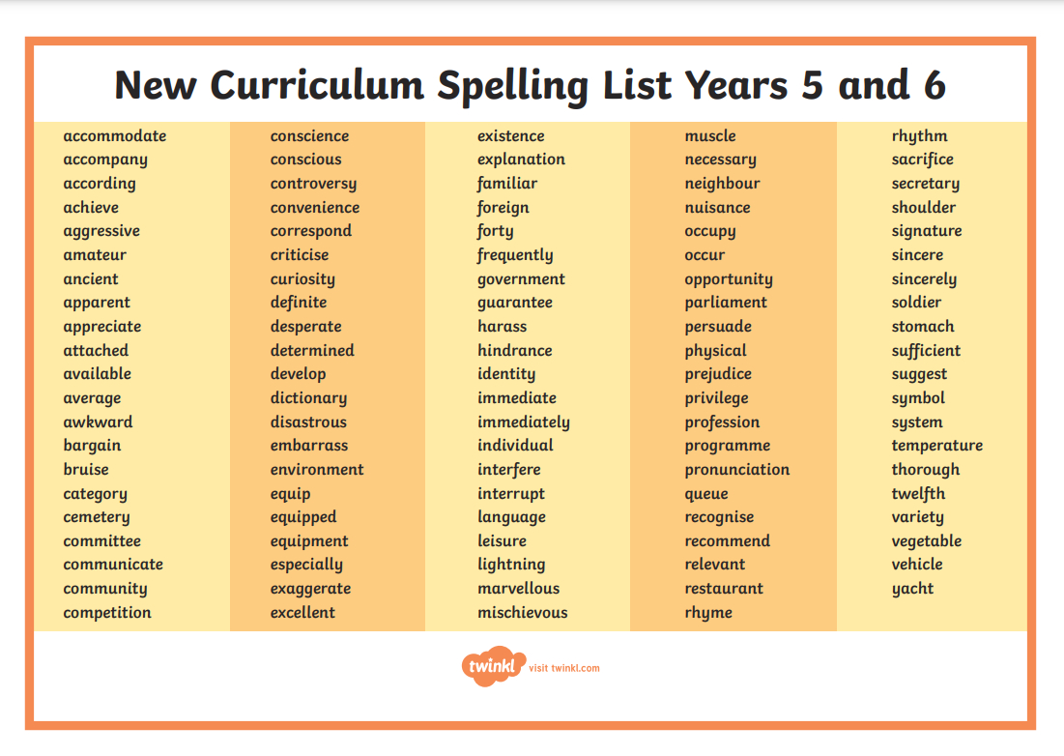
Assessment of Spelling and Word Study
At the end of every half term, the children are assessed on the roots that we have learnt throughout the half term.
In Year 6, the children will also take a spelling SATs test which will include these words, words from throughout their time at school and those on the Year 5/6 word list.
Notes:
Word List hand out

Slide 15
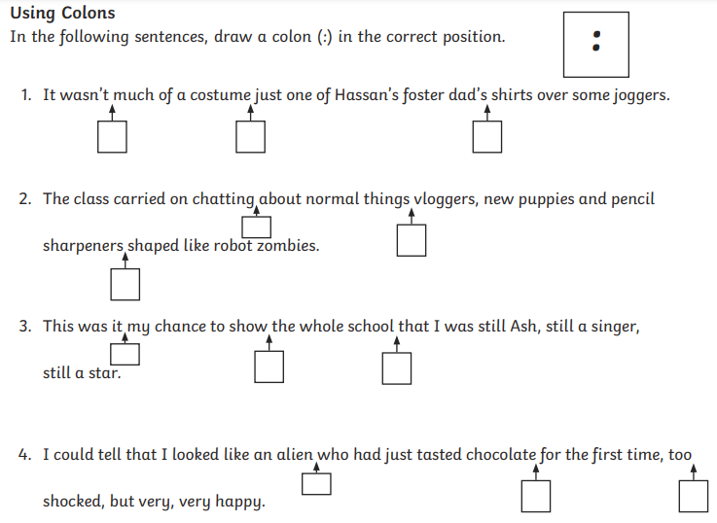
Grammar
2 ways that Grammar is taught at HPS…
Through ‘SPAG Starters’ at the beginning of every lesson.
Embedded within the writing journey as relevant to the text we are writing.
Notes:
Two ways Grammar is taught.

Slide 16
Presentation
‘Maintain legibility in handwriting when writing at speed.’

Slide 17
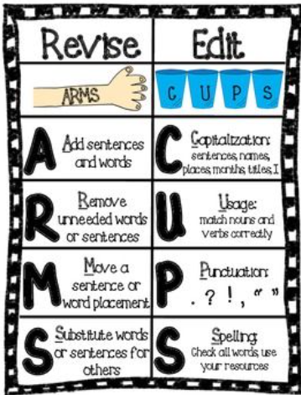
Editing and Improving
In Upper Key Stage 2, Editing and Improving is a really important part of the writing process. (No one gets everything right first time)

Slide 18
Revisit and Enrich
At Hamble, we have dedicated ‘revisit and enrich’ sessions. One of which we try to make English based.
These are targeted tasks for the children and input is given based on this.
These are planned based on the children’s needs and informed by their work and feedback within lessons.

Slide 19
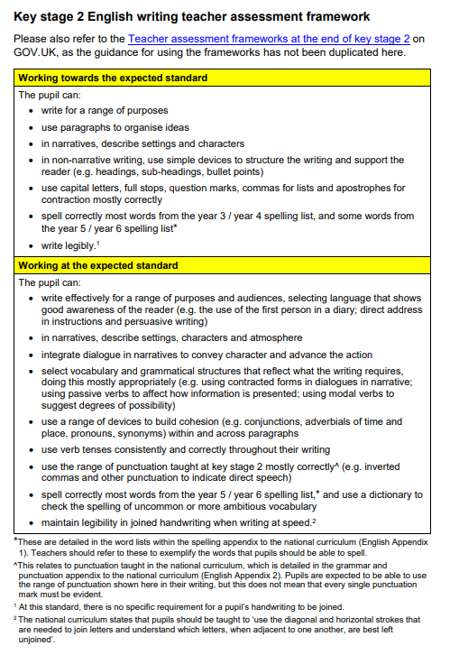
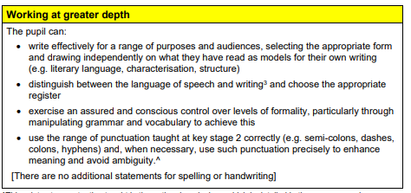
Assessment and Marking
A copy of our marking policy can be found on our website. – marking and feedback policy.
Notes:
Add marking grid

Slide 20
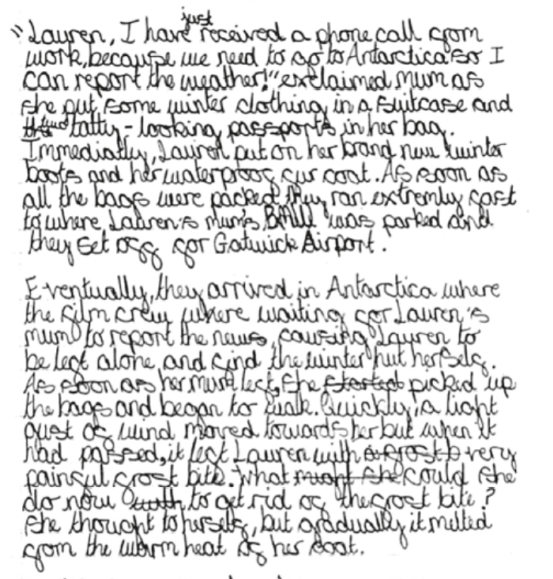

Slide 21
Thank you! Any questions?

