Slide 1
Parent information session UKS2 Maths – Year 5 and 6
Virtual Meetings
Please put your name and your child’s first name and year group in the chat bar.
If you have any questions please write them in the chat bar and we will answer as many of these as possible at the end of the session. If we have questions outstanding, we will do a FAQ page and send this out.
Due to Zoom timing restraints, this meeting will cut off after 40 minutes.

Slide 2
KS2 Maths
General curriculum overview
Expectations for the end of each year group
Calculation policy
Where to find it
How to use it
Arithmetic and maths meetings
TTRS and SATS Companion
Revisit/EMAs
Things you could do to help at home

Slide 3
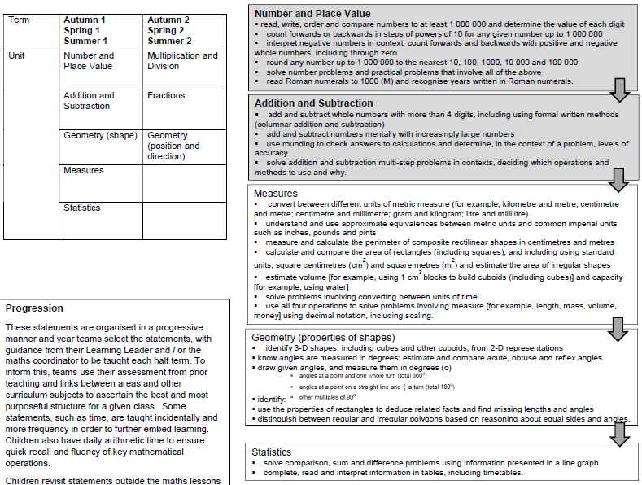
Maths Curriculum Overview – Year 5

Slide 4
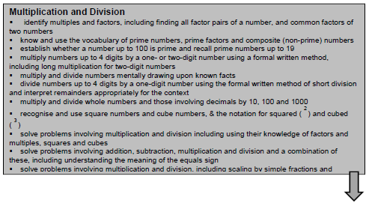
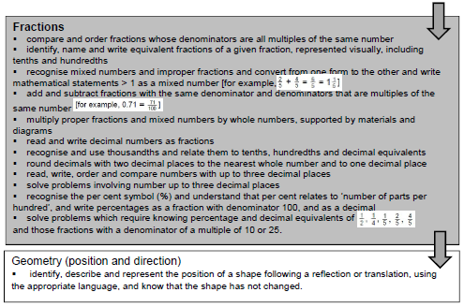
Maths Curriculum Overview – Year 5

Slide 5
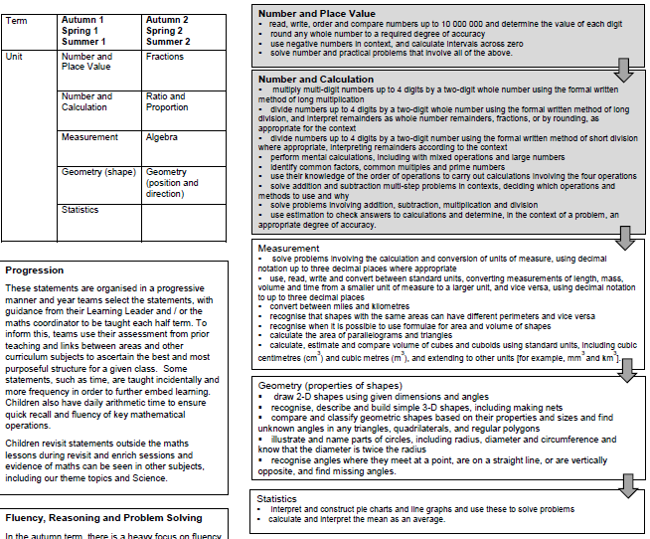
Maths Curriculum Overview – Year 6

Slide 6
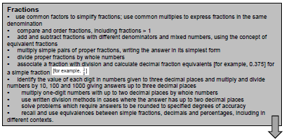
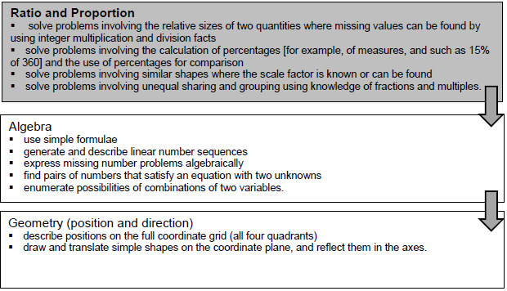
Maths Curriculum Overview – Year 6

Slide 7
KS2 Maths
End of Year 4 expectations:
Count in multiples of 25 and 1000
Find 1000 more or less than a number
Count in negative numbers
Place value of 4-digit numbers (thousands, hundreds, tens and ones)
Order and compare numbers beyond 1000
Round any number to the nearest 10, 100, 1000
Use column addition and subtraction as well as developing mental fluency
Multiply 2- and 3-digit numbers by 1-digit numbers
Multiply 3 numbers together
Recall multiplication and division facts for times tables up to 12 x 12
Recognise equivalent fractions
Recognise and count in hundredths
Find fractions of a quantity
Add and subtract fractions with the same denominator
Recognise decimals of ½, ¼, ¾, tenths and hundredths

Slide 8
KS2 Maths
End of Year 5 expectations:
Read, write, order and compare numbers up to at least 1,000,000 and understand the place value of each digit
Count forwards and backwards in powers of 10 for any number up to 1,000,000
Interpret negative numbers in context – counting forwards and backwards
Round any number up to 1,000,000 to the nearest 10, 100, 1000, 10,000 and 100,000
Use column addition and subtraction and mental calculation for increasingly large numbers
Solve multi-step problems including addition and subtraction
Identify multiples and factors of numbers, knowing if a number is prime or composite too
Multiply up to 4-digits by 1- or 2-digit number using a written method
Multiply and divide numbers mentally using known facts
Divide numbers up to 4-digits by 1-digit using short division and understand remainders
Multiply and divide whole numbers and decimals by 10, 100 and 1000
Recognise mixed numbers and improper fractions and convert between them
Add and subtract fractions with the same denominator and ones that are multiples of the same number
Multiply fractions by whole numbers
Read and write decimal numbers as fractions
Recognise thousandths as fractions and decimals
Recognise and understand per cent

Slide 9
KS2 Maths
End of Year 6 expectations:
Read, write, order and compare numbers up to at least 10,000,000 and understand the place value of each digit
Use negative numbers in context
Round any whole number to a required degree of accuracy
Multiply multi-digit numbers up to 4-digit by 2-digit using long multiplication
Divide numbers up to 4-digit by 2-digit using long division and short division and interpret remainders as whole numbers, fraction or by rounding – appropriate to context of a given question
Perform mental calculations, including with mixed operations and large numbers
Identify common multiples and factors of numbers and prime numbers
Understand the order of operations (BIDMAS) to carry out operations involving the 4 operations
Solve multi-step problems
Use common factors and multiples to simplify fractions
Compare and order fractions
Add and subtract fractions with different denominators and mixed numbers
Multiply simple pairs of fractions
Divide proper fractions by whole numbers
Identify value of each digit up to 3 decimal places
Recall and use equivalences between simple fractions, decimals and percentages

Slide 10
Maths Calculation Policy
The Maths Calculation Policy, which can be found on our website, shows you how we teach key concepts in school at each year group and it may help you to understand what your child is referring to in a given maths topic.
It is split into four different areas (referred to as the ‘BIG 4’)
These are:
Addition
Subtraction
Multiplication
Division
It takes you through the stages of each of these for each year group, starting with year 1.

Slide 11
Maths Calculation Policy

Slide 12
Maths Calculation Policy

Slide 13
Maths Calculation Policy
This is an example, taken from the first page of the calculation policy.
Concrete
Pictorial
Abstract

Slide 14
Maths Calculation Policy

Slide 15
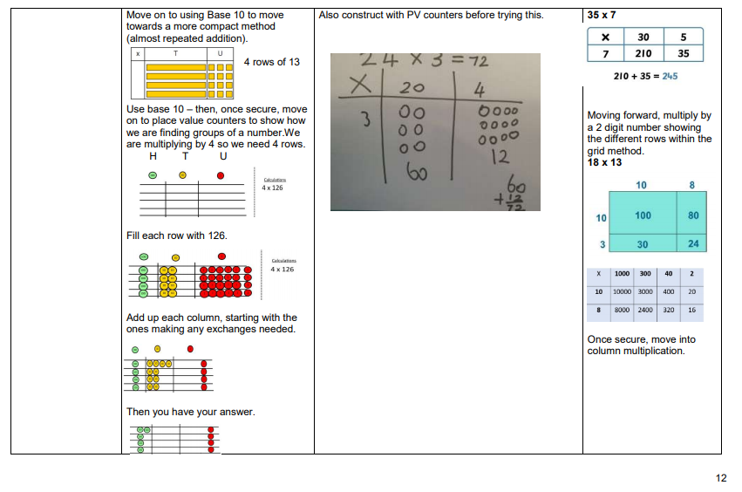

Slide 16
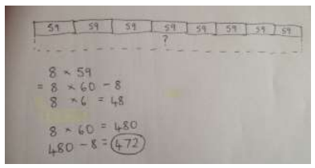

Slide 17
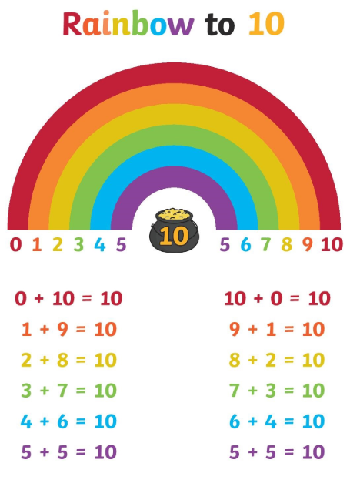
Arithmetic (Daily)
Number bonds
What is a number bond and when are these taught? What number bonds does your child need to know and when?
Why are these important?
How these are vital for your child to apply now in these later year groups.
How to help your child with these.

Slide 18
Arithmetic
Quick mental strategies
- Quick / automatic recall of times tables
Family of facts
- Holding a number in your head and counting on
e.g. 1703 + 5
Counting past and over the 100 / 1000 markers.
297 + 6 = ___
Questions written in a different order and using what we know to work them out _____ + 200 = 324
Using known facts to solve different calculations e.g. 70 x 3 = ___ or 720 ÷ 8 = ___
Finding fractions/percentages of amounts – ¾ of 72 = ____

Slide 19
Arithmetic
Monday – Times tables
Tuesday – Known/related number facts
Wednesday – Multiplying and dividing by powers of 10
Thursday – Fractions and percentages
Friday – Part of a SATs paper (reasoning and arithmetic)
Will have more algebra from after Christmas.

Slide 20
Maths Meeting
Revisiting previously taught concepts, deepening thinking, applying facts and fluency knowledge to different contexts…

Slide 21
Maths Meeting
Supporting reasoning and problem-solving – oral discussion – pushing mathematical vocabulary and challenging thinking…

Slide 22
Revisit and Enrich
These are targeted sessions to support children with areas of maths that they have found particularly challenging and need to revisit. These are supported by the completion of homework. There are enrichment tasks to further challenge children who are already secure in this particular area of maths.
EMA time – crucial revisit time with targeted adult support so prompt arrival at school is key for children to make effective use of this time!

Slide 23
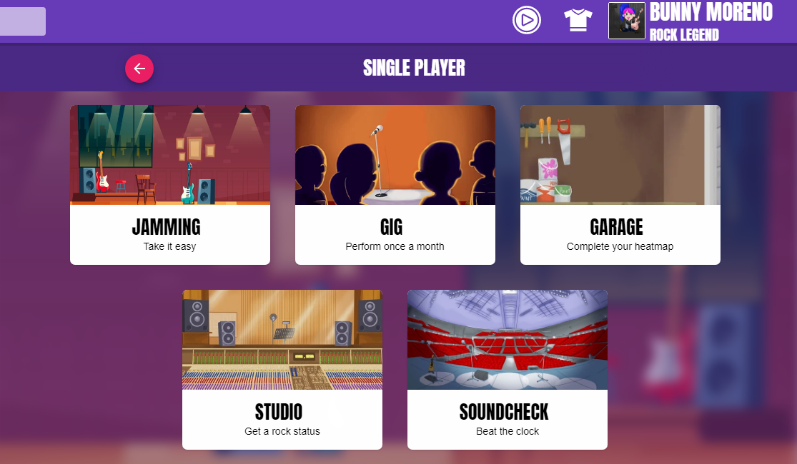
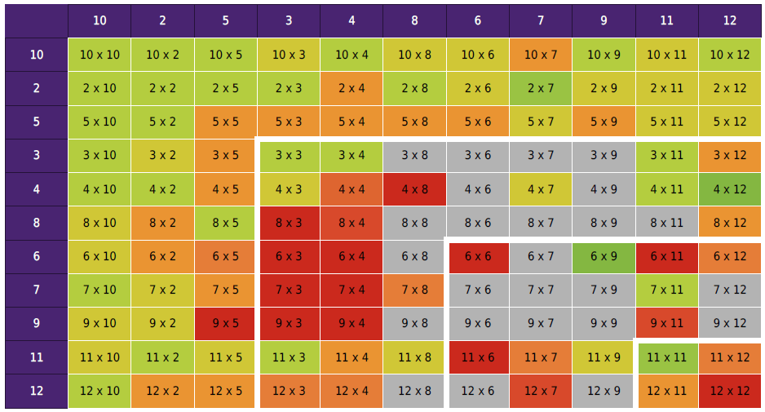
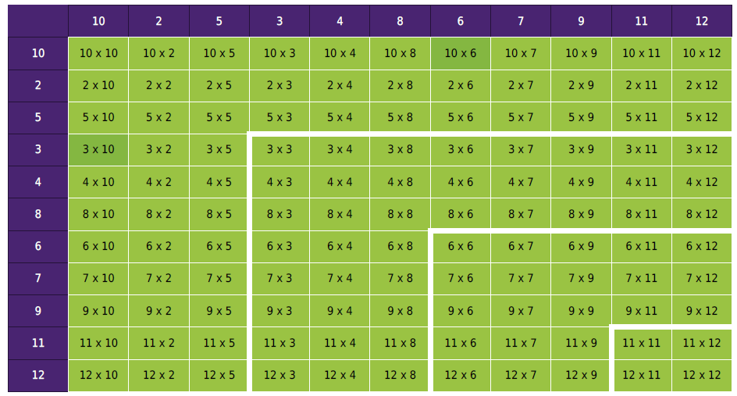
Multiplication
TTRS

Slide 24
Multiplication
Times Tables
Chanting and singing (old-fashioned, but effective!)
Listening to and singing along to times tables songs (many can be found on Youtube - but worth an adult watching them first to check the content. Also the link above to BBC Supermovers has some catchy songs!)
Writing the number patterns down and writing them in and out of order.
Making a set of number cards labelled 1-12, shuffling them, turning them over one at a time and multiplying it by the table being learnt.
Quick fire questions on the way to school! Get your child to write the answers down first and then use that to find the answers quickly yourself if you aren’t confident.
Completing multiplication grids – timed challenges can improve efficiency

Slide 25
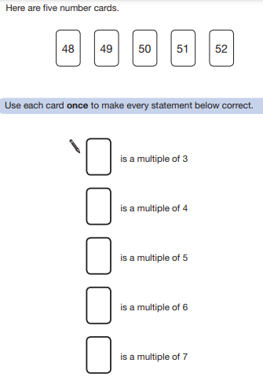
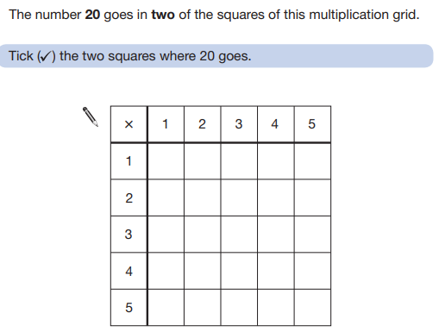
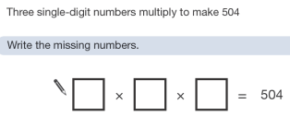
Multiplication
Examples from SATs Papers

Slide 26
Multiplication
Link to fractions
For calculating fractions of amounts, we teach the children to divide by the denominator and multiply by the numerator.
E.g. ¾ of 28
We would do 28 ÷ 4 = 7 (to find ¼), then we would multiply the answer by 3. 7 x 3 = 21. So ¾ of 28 = 21.
This strategy relies on multiplication and division fact recall.

Slide 27
SATs Companion - Homework
This is set weekly by the Year 5 and Year 6 teachers. It is expected to be completed by the children each week and their teachers will check their progress of this. It is set to suit different needs but still focusing on the same topic.
All of the work set is not random! It is set generally based on what has already been taught so it is a chance for the children to revisit this learning/ consolidate. If they are finding this difficult, their teachers will be able to see this and provide support in school as required.
The children can send a message to their teacher if they need help!

Slide 28
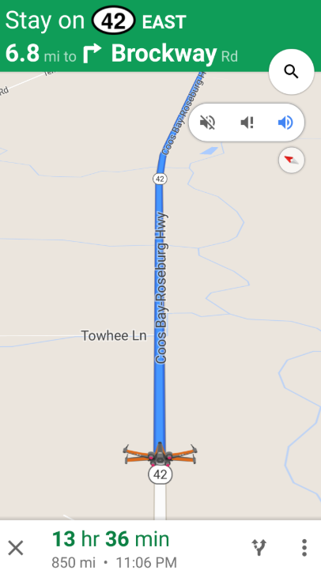
Incidental Maths
Maths is everywhere and must be made real for children! While we deliver formal maths lessons in school, it is difficult for children to appreciate the role this knowledge has in everyday life. We can tell them the knowledge they need but children often secure understanding when they regularly experience maths first hand.
Encourage your child to recognise the maths around them daily.
If it takes us 5 minutes longer, what time will we arrive?

Slide 29
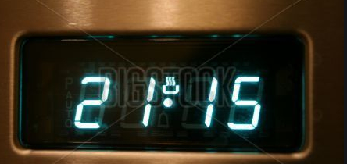
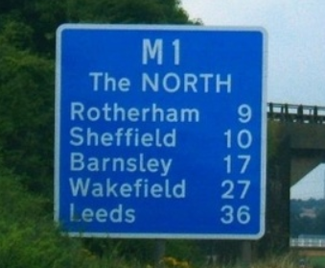
Incidental Maths
Children see maths in their daily lives routinely and the best way to learn is to help children identify these. For example:
Finding, comparing and discussing shapes in and around the house
Allowing children to be hands-on and do the measuring. This includes them reading scales and converting units e.g. mm to cm / ml to l / g to kg.
Telling the time and talking about it – using different clocks (cooker, wall clock etc) and asking children questions such as, ‘How long until…’ and ‘In 3 and a half hours we will be….’
In the car. For example, reading signs on motorways / converting distances / understanding what a mile feels like / sat-nav times.
Looking at different types of timetables (bus, train, cinema etc.) to explore time, money (ticket prices)
Looking at weather forecasts – what do they tell us about temperatures, percentages used, comparing weather at different times of day/across different days

Slide 30
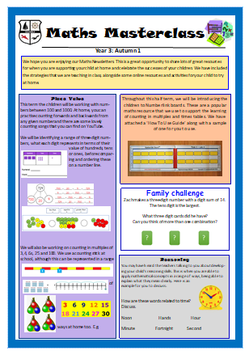
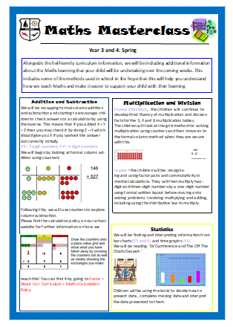
Thanks for listening!
Any questions, please ask!

