Slide 1
Reading and Writing in
Years 3 and 4
Virtual Meetings
Please put your name and your child’s first name and year group in the chat bar.
If you have any questions please write them in the chat bar and we will answer as many of these as possible at the end of the session. If we have questions outstanding, we will do a FAQ page and send this out.
Due to Zoom timing restraints, this meeting will cut off after 40 minutes.

Slide 2
Reading at Hamble Primary School
Reading is a vitally important part of a child’s development and is a key life skill. At Hamble Primary School we believe that every child can learn to read with the right help and support, and we endeavor to instill a love of reading within all children. We place reading and books at the center of our English curriculum, as well as, using books as a stimulus and to support learning across the wider curriculum.
Notes:
Reading statement

Slide 3

Phonics – Where it all started!

Slide 4
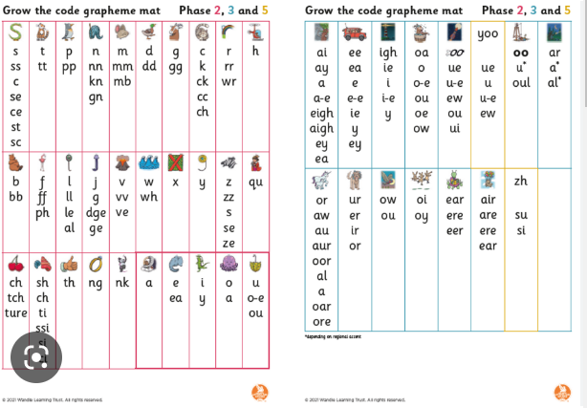
Phonics is the recommended strategy through which children should be taught to learn to read.
There are some children in Year 3 and 4 for which phonics is still a core part of their reading and writing. Therefore, there are phonics based supports and resources provided in classrooms by staff.
Please remember that this is also helpful for all children, as this is how they originally learnt to read.
This is also particularly helpful when supporting children with their spelling and a ‘Grow the Code’ chart is visible in every classroom.
You can find more information about phonics
on our website –
Parents – ‘Phonics information and how to
help your child at home.’
Notes:
LWLSR is one of the phonics schemes approved by the DFE.
Phonics is a whole school approach- not just Year R.

Slide 5
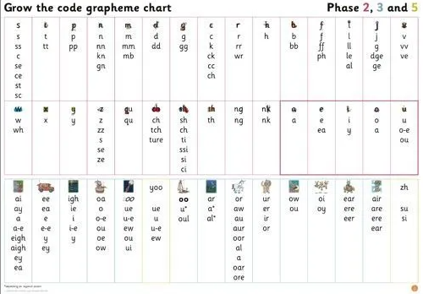

Slide 6

So, how is our journey mapped out?
In a typical 6 week half term, the children’s learning would look like this…
Week 1 | Week 2 | Week 3 | Week 4 | Week 5 | Week 6
Narrative Week A text linked to our upcoming theme is used to teach the vocabulary needed and revisit several reading skills previously taught. | Theme Week As a school, we use this week to immerse the children in their theme learning to ensure complete foundation learning. This can then be used to support reading and writing later in the term. | Theme Writing Week The children use what they have learnt in their theme week to complete a piece of writing. | Writing The teaching of grammar and writing elements to support a further written piece- based on a linked text. | Writing The children complete a writing unit where they can apply the grammar and skills they have been taught. | Writing The children complete a writing unit where they can apply the grammar and skills they have been taught.
 |  | Fluency A speaking and language unit to support fluency and prosody within reading. | Reading Skills based unit based on a parallel text. | Reading Skills based unit based on a parallel text. | Reading Skills based unit based on a parallel text.
Notes:
The reason that this is a ‘Narrative’ week is because this is where we find children are most successful – this is also heavy throughout other units.

Slide 7
Reading
We follow a skills-based curriculum in Reading but this is always based around quality texts with many being relevant to our theme. This is designed to give children the skills they need to work with any text that they are given, by working on familiar concepts and text types first.
The skills are as follows:
Retrieval: Getting basic information from a text.
Inference: Using evidence from the text to reach a conclusion.
Vocabulary: Using what you already know to work out the meaning of unknown words.
Themes and Conventions: Using the way that a text is written or presented to work out the message or purpose of a text. (This also helps us to write our own sometimes!)

Slide 8
Skimming and Scanning: Using the layout of a text to quickly skim to get an overall picture (getting the gist) or scan to quickly find an answer.
Authorial Intent: Thinking carefully about an Author’s choices with regard to vocabulary, presentation or features used. We talk a lot here about how this impacts the reader and how to be most effective when writing.
Visualisation: Thinking about the picture that is built within a narrative and how this helps the reader to understand the text. Again, this is used a lot in our narrative writing.
Monitoring and Clarifying – This is used to ensure that children understand what is happening throughout a whole text. This could be following the events, movements of a character or understanding a non-fiction thoroughly.
Practising these skills can also be something that can be carried through to your reading at home. You should find support for this on our website:
Parents – ‘Reading Newsletters’

Slide 9
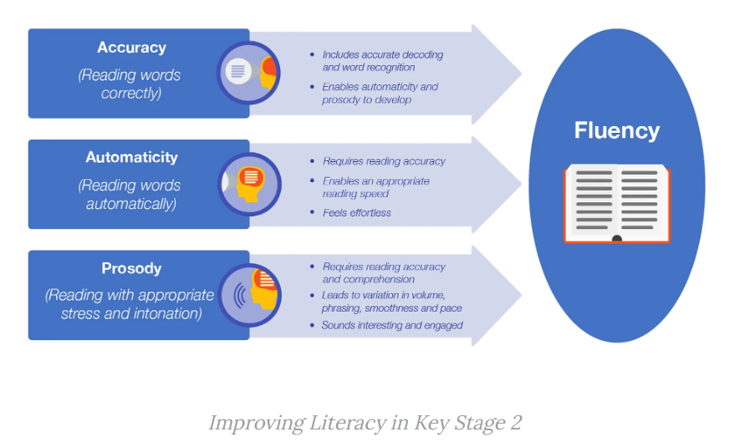
Reading Fluency
To build on the children’s previous phonics learning and support their ability to read ‘well’ we have half-termly ‘fluency’ units.

Slide 10
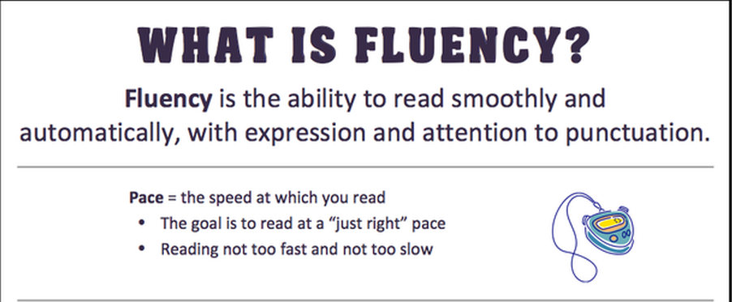
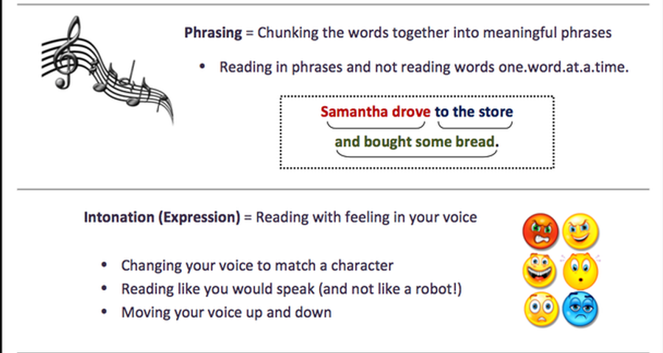
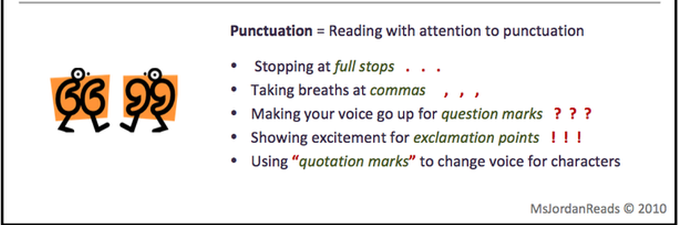

Slide 11
Reading Fluency
What parents can do to help at home:
Support and encourage your child. Realise that he or she is likely frustrated by reading if this is something they struggle with.
If your child can decode words well, help him or her build speed and accuracy by:
  Reading aloud and having your child match their voice to yours (paired reading)
  Having your child practise reading the same list of words, phrase, or short passages several times – we promote 3 reads at Hamble.
  Reminding your child to pause between sentences and phrases
Read aloud to your child to provide an example of how fluent reading sounds.
Give your child books with predictable vocabulary and clear rhythmic patterns so they can ‘hear’ the sound of fluent reading as he or she reads the book aloud.
Use audiobooks and have your child follow along in the print copy or just listen for the experience.
Notes:
EEF blog: Shining a spotlight on reading fluency

Slide 12


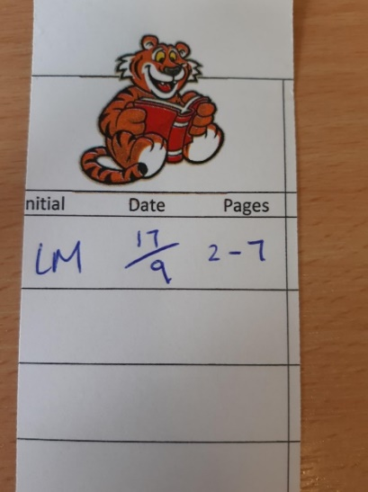
Reading at home
Our Library | SORA E-Library/ BigCat books | Reading Passport
All classes visit the library once per week where they can change and choose their own book. The teachers will keep an eye on what the children choose but the children are free to choose. | SORA E-Library is and app/website that we have signed up to as a school where children can access E-Books and Audio Books. Your child should be able to log-in via their Google Classroom log-in. This can be found on parentmail. Big Cat may be necessary for some children and this has a separate log-in. You should already know if this is relevant for your child. https://soraapp.com/home | Please continue to record any reading done at home on your child’s reading bookmark.

Slide 13
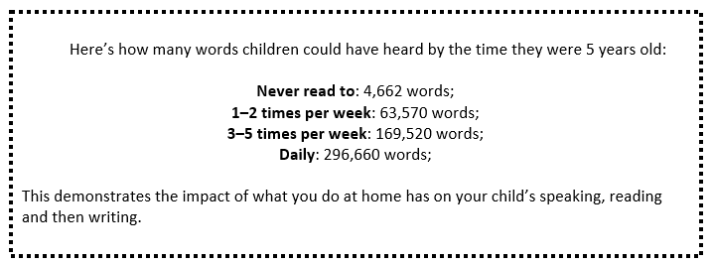
How you can help at home
Regular reading is key!!!!!
Notes:
Evidence suggests that reading for pleasure leads to increased attainment. Clark and DeZoya (2011) found a significant positive relationship between enjoyment and attainment indicating that pupils who read more are also better readers.

Slide 14

What do we mean by ‘Word Study’?
Etymology – the history of the word
Morphology – parts of the words that have meaning
Phonology/Orthography – how the word sounds/spelling rules
E.g. Recycling
Re cycle ing
again ‘circle, wheel’ present continuous verb

Slide 15
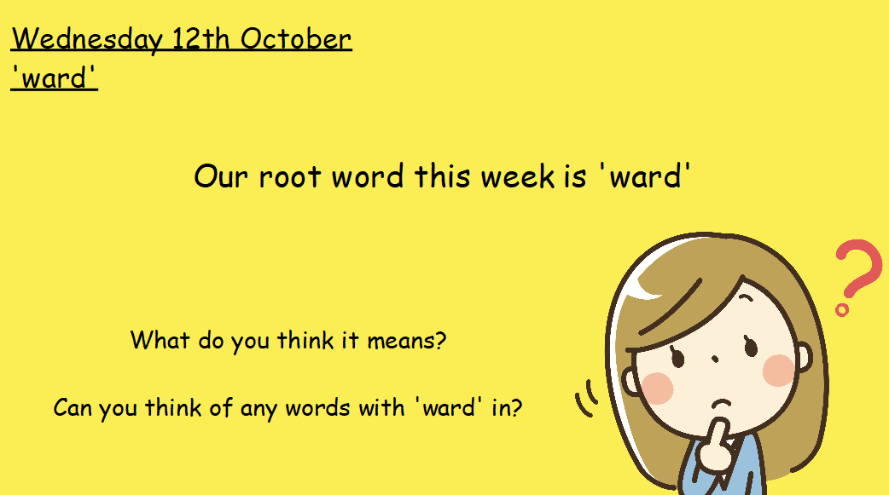
Word Study
Notes:
Hampshire advocated approach – helping children to build knowledge of words and adapt this and rules to other words.

Slide 16
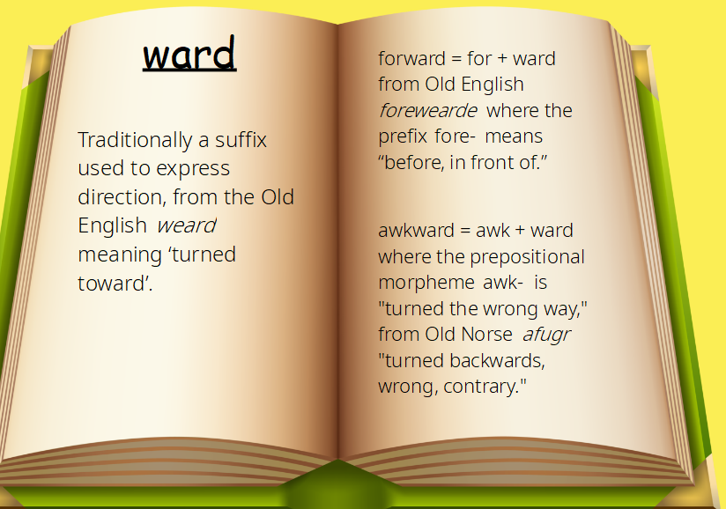

Slide 17
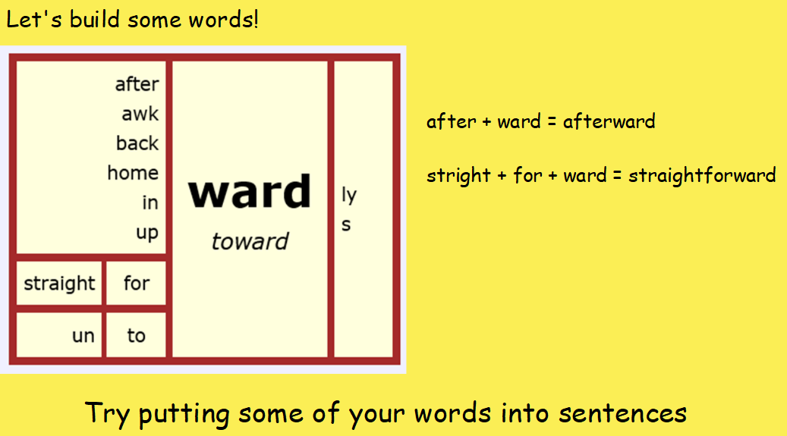

Slide 18
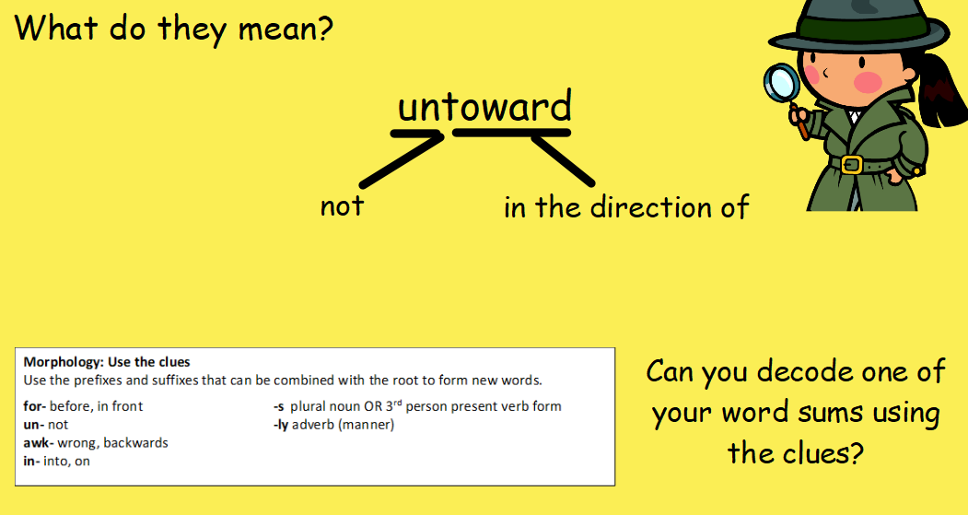

Slide 19
Thank you!
Any questions?

