Slide 1
Parent information evening KS1 Maths
Virtual Meetings
Please put your name and your child’s first name and year group in the chat bar.
If you have any questions please write them in the chat bar and we will answer as many of these as possible at the end of the session. If we have questions outstanding, we will do a FAQ page and send this out.
Due to Zoom timing restraints, this meeting will cut off after 40 minutes.

Slide 2
KS1 Maths
General curriculum overview
Expectations for the end of each year group
Calculation policy
Where to find it
How to use it
Arithmetic
Number bonds
Mental strategies
Numbots and TTRS
Help at home

Slide 3
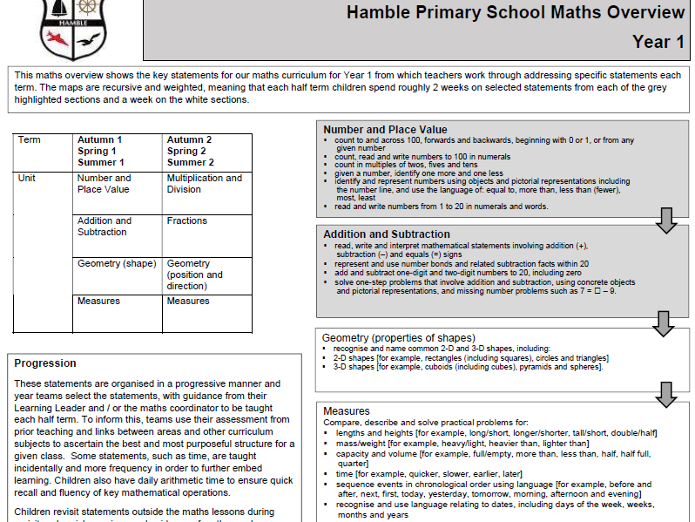
Maths Curriculum Overview – Year 1

Slide 4
Maths Curriculum Overview – Year 1

Slide 5
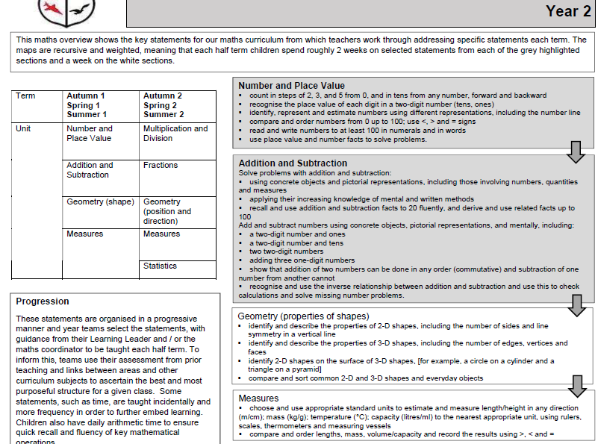
Maths Curriculum Overview – Year 2

Slide 6
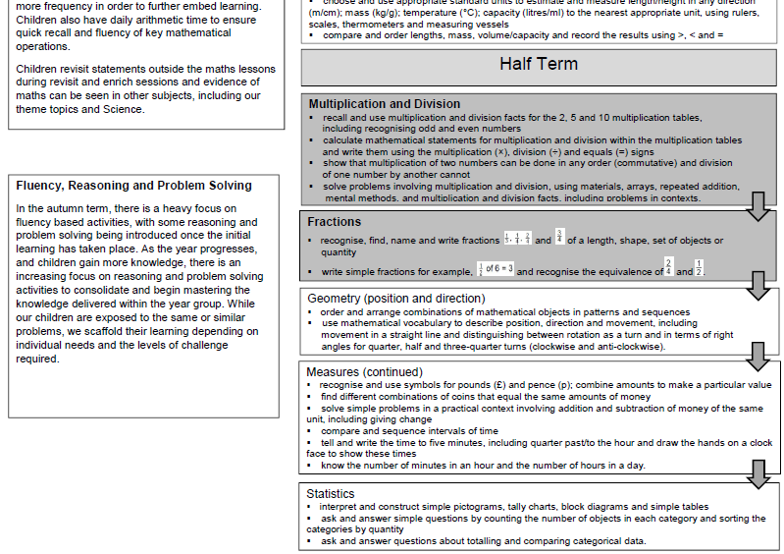
Maths Curriculum Overview – Year 2

Slide 7
KS1 Maths
End of Year R expectations:
Deep understanding of numbers to 10 – quantity, value, touch- counting, recognition, ordering, writing
Composition of numbers and simple calculations – 5 can be 1 and 4, 2 and 3, 3 and 2, 4 and 1
Instantly recognise quantities up to 5 without counting
Automatically recall number bonds to 5 (including subtraction) and some number bonds to 10, including doubling facts
Verbally count beyond 20 (including odd and even)
Compare quantities up to 10 – greater than, less than,
same as/equal to

Slide 8
KS1 Maths
End of Year 1 expectations:
Count to and across 100, from 0/1 or any given number
Read and write numbers up to 100
Count in multiples of 2, 5 and 10 (forwards and backwards)
1 more and 1 less than a number
Read and write numbers up to 20 in numerals and words
Use number bonds within 20 (linking addition and subtraction)
Add and subtract 1-digit and 2-digit numbers to 20
(could be 19 + 19) – recognising different symbols
Missing number problems (7 = ___ - 9)
Multiplication and division (using arrays, lots of)
Recognise ½, ¼ and whole

Slide 9
KS1 Maths
End of Year 2 expectations:
Count in multiples of 2, 3, 5 and 10 (forwards and backwards)
Place value of numbers (tens and ones)
Compare and order numbers up to 100 (<, > and =)
Read and write numbers up to 100 in numerals and words
Recall and use add and subtract facts to 20
Derive and use related facts up for addition and subtraction up to 100
Add and subtract: 2-digit and ones, 2-digit and tens, two 2-digit numbers
Add three 1-digit numbers
Multiplication and division – recall and use 2, 5 and 10 times tables and apply these to problems
Recognise 1/3, ¼, 2/4 and ¾; 2/4 = ½; find fractions of a quantity (1/2 of 6 = 3)

Slide 10
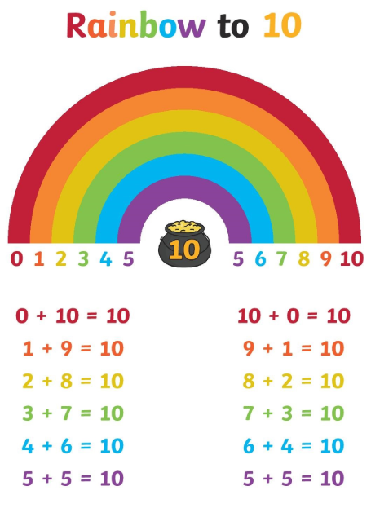
Arithmetic
Number bonds
What is a number bond and when are these taught? What number bonds does your child need to know and when?
Why are these important?
How these are useful and applied in later year groups.
How to help your child with these.

Slide 11
Arithmetic
Quick mental strategies
- Quick / automatic recall of times tables (Year 2)
Family of facts
- Holding a number in your head and counting on or back
e.g. 17 + 5
Put 17 in your head and hold up 5 fingers to count on. Progressing onto bridging in Year 2 – partition 5 into +3 and +2 (get to the next 10 and then carry on adding).
Questions written in a different order and using what we know to work them out
_____ + 10 = 32

Slide 12
Maths Calculation Policy
The Maths Calculation Policy, which can be found on our website, shows you how we teach key concepts in school at each year group and it may help you to understand what your child is referring to in a given maths topic.
It is split into four different areas (referred to as the ‘BIG 4’)
These are:
Addition
Subtraction
Multiplication
Division
It takes you through the stages of each of these for each year group, starting with year 1.

Slide 13
Maths Calculation Policy

Slide 14
Maths Calculation Policy

Slide 15
Maths Calculation Policy
This is an example, taken from the first page of the calculation policy.
Concrete
Pictorial
Abstract

Slide 16
Maths Calculation Policy

Slide 17
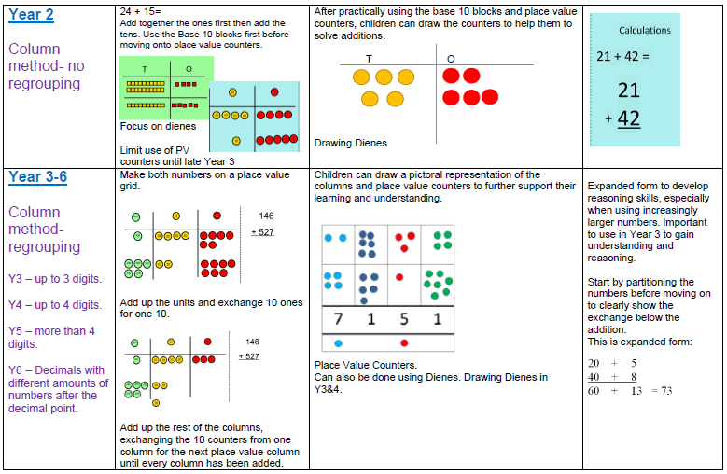

Slide 18
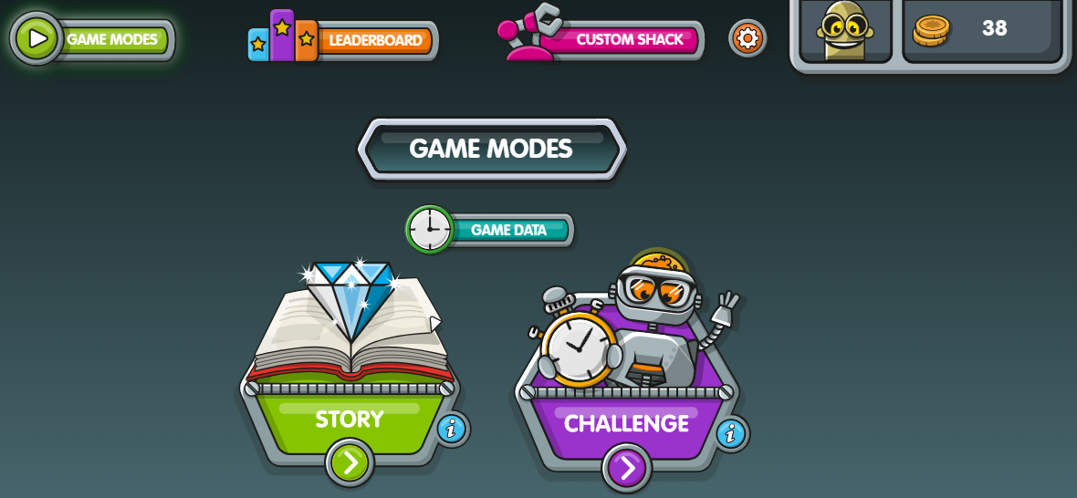
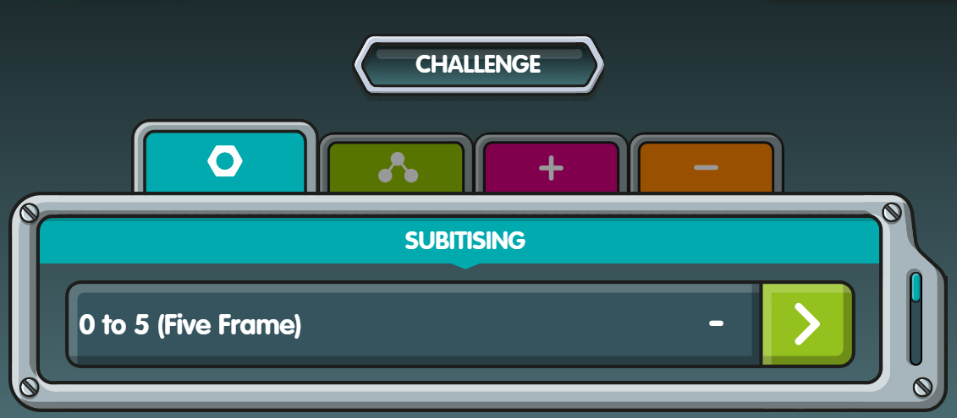
Numbots
Number bonds

Slide 19
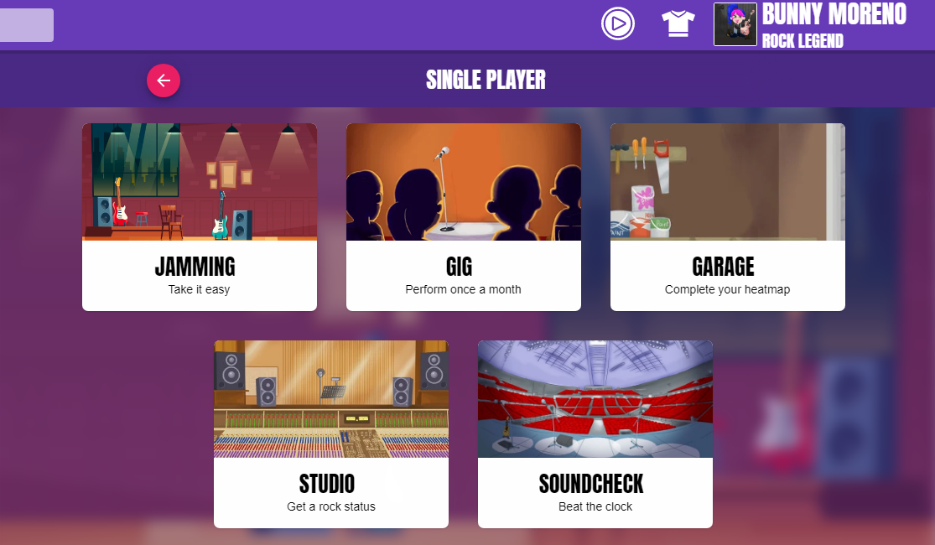
Multiplication
Times Tables

Slide 20
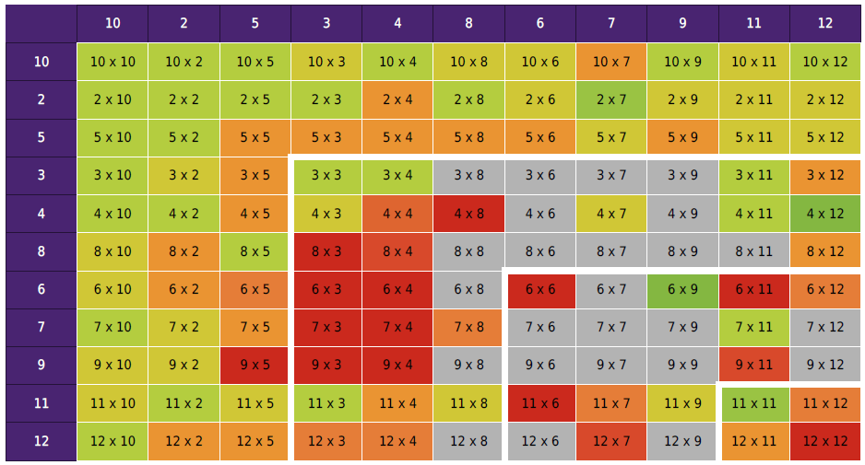
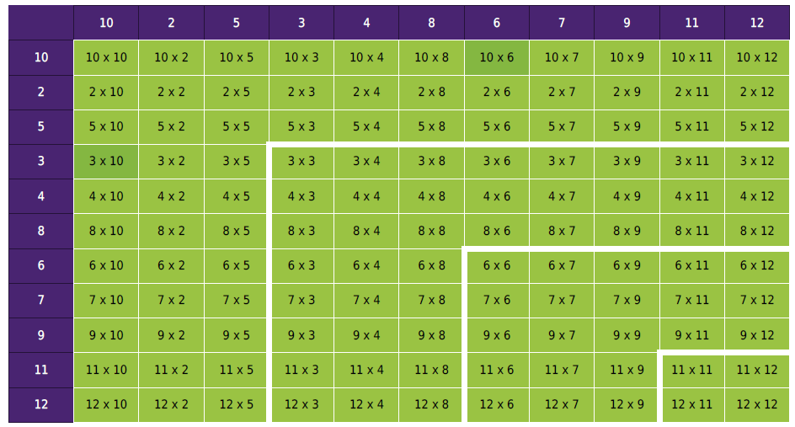
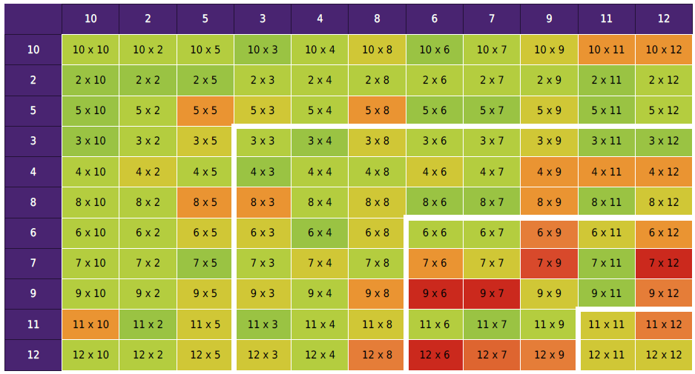
Multiplication
Times Tables

Slide 21
Multiplication
Times Tables

Slide 22
Multiplication
Times Tables
Year 1 – counting patterns
Year 2 – quick recall of times tables (10, 5, 2) and counting in 3s

Slide 23
Multiplication
Times Tables
Chanting and singing (old-fashioned, but effective!)
Listening to and signing along to times tables songs (many can be found on Youtube - but worth an adult watching them first to check the content. Also BBC Supermovers has some catchy songs!)
Writing the number patterns down and writing them in and out of order.
Making a set of number cards labelled 1-12, shuffling them, turning them over one at a time and multiplying it by the table being learnt.
- Quick fire questions on the way to school! Get your child to write the answers down first and then use that to find the answers quickly yourself if you aren’t confident.

Slide 24
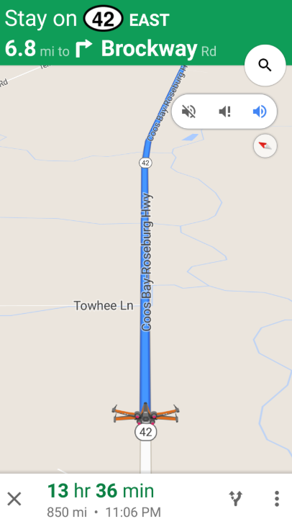
Incidental Maths
Maths is everywhere and must be made real for children! While we deliver formal maths lessons in school, it is difficult for children to appreciate the role this knowledge has in everyday life. We can tell them the knowledge they need but children often cement understanding when they regularly experience maths first hand.
Encourage your child to recognise the maths around them daily.
If it takes us 5 minutes longer, what time will we arrive?

Slide 25
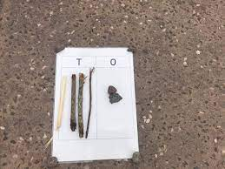
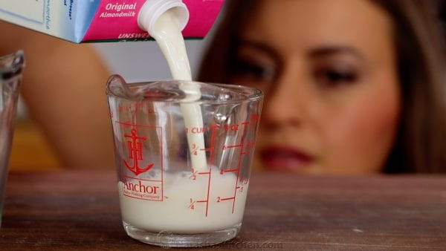
Incidental Maths
Children see maths in their daily lives routinely and the best way to learn is to help children identify these. For example:
Finding and discussing shapes in and around the house or when you’re out and about (road signs, shapes in nature).
Allowing children to be hands-on and do the measuring when cooking and baking. This includes them reading scales and counting out quantities.
Telling the time (half past and o’clock in Year 1, nearest quarter of an hour for Year 2 and nearest 5 minutes as a GDS Year 2).
Sharing out sweets – linking to multiplication, division and fractions.
Play hit the button - https://www.topmarks.co.uk/maths-games/hit-the-button

Slide 26
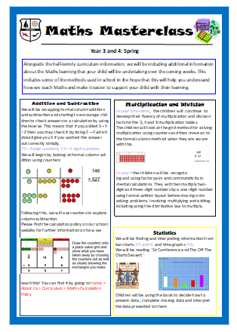
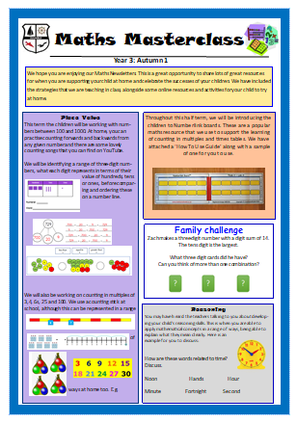
Thanks for listening!

