Slide 1
Phonics
Physical Development
Virtual Meetings
Please put your name and your child’s first name and year group in the chat bar.
If you have any questions please write them in the chat bar and we will answer as many of these as possible at the end of the session. If we have questions outstanding, we will do a FAQ page and send this out.
Due to Zoom timing restraints, this meeting will cut off after 40 minutes.

Slide 2
Reading at Hamble Primary School
Reading is a vitally important part of a child’s development and is a key life skill. At Hamble Primary School we believe that every child can learn to read with the right help and support, and we endeavour to instill a love of reading within all children. We place reading and books at the core of our English curriculum, as well as, using books as a stimulus to support learning across the wider curriculum.
Notes:
Reading statement

Slide 3
Phonics
Phonics is the recommended strategy through which children should be taught to learn to read. As a school we use the complete systematic synthetic phonics programme, Little Wandle Letters and Sounds Revised.
There are 5 phases in Little Wandle Letters and Sounds . It runs alongside other teaching methods such as whole class reading sessions and sharing stories to help children develop vital skills and give them a real love of reading.
Notes:
LWLSR is one of the phonics schemes approved by the DFE.
Phonics is a whole school approach- not just Year R.

Slide 4
Phase 1
Tuning into sounds –
1) Environmental sounds,
2) Instrumental sounds,
3) Body percussion,
4) Rhythm and Rhyme,
5) Alliteration,
6) Voice sounds
7) Oral blending and segmenting
Listening to and remembering sounds
Talking about sounds
Notes:
Pre-school and beginning of Year R
Continue this throughout the year

Slide 5
www.littlewandlelettersandsounds.org.uk
Phase 2
Teaching the first 19 letter sounds.
Pure sounds- pronunciation is key!
GPC- using the correct sounds which correspond with the letters they are reading.
Begin to segment and blend CVC words.

Slide 6
Phase 3
Digraphs and trigraphs
Blending for reading
Segmentation for spelling
Tricky words
Notes:
Year R- once developed GPC and confidently segmenting and blending phase 2
Recapped at beginning of Year One for consolidation

Slide 7
Key Vocabulary
Phoneme – A unit of sound.
Grapheme – The way a phoneme is represented in writing.
GPC - Grapheme to Phoneme Correspondence: the individual letters or letters strings which represent individual sounds in the language, i.e. the way a letter ‘sounds’ when it is read aloud.
Segment – The breaking up of a word into the individual phonemes that it consists of, e.g. ‘sit’ = /s/ /i/ /t/
Blend – The joining of phonemes when they are said aloud, to form a word.
Notes:
Phoneme is the sound it makes
Grapheme is the way it looks in writing.

Slide 8
Digraphs- 2 letters that make 1 sound, e.g.
Trigraphs- 3 letters that make 1 sound, e.g.
igh light ear hear air fair
th them
sh fish

Slide 9
Sound buttons
Segmenting e.g. s a t
Blending

Slide 10
Tricky words
(previously ‘sight words’)
Words that have a part that cannot be read using phonics, e.g. to, me, come. These are taught as part of phonics sessions.

Slide 11
Vocabulary
Wide range of texts
Discussing meaning of words- encouraging children to ask!
Checking understanding and clarifying meaning

Slide 12
Reading aloud
Why do we re-read texts several times?
Decoding- children segment and blend to read.
Prosody- work on fluency and expression.
Comprehension- ask questions about what they have read to show their understanding.
Notes:
How do you know?- Justify!!!!!!!!!!!!

Slide 13
Physical Development

Slide 14
Physical Development
“Physical activity is vital in children’s all-round development, enabling them to pursue happy, healthy and active lives. Gross and fine motor experiences develop incrementally throughout early childhood”
(Educational Programmes- EYFS Statutory Framework 2021)

Slide 15
Physical Development
“Gross motor skills provide the foundation for developing healthy bodies and social and emotional wellbeing.”
“Fine motor control and precision helps with hand-eye co-ordination which is later linked to early literacy.”
(EYFS Statutory Framework 2021)

Slide 16
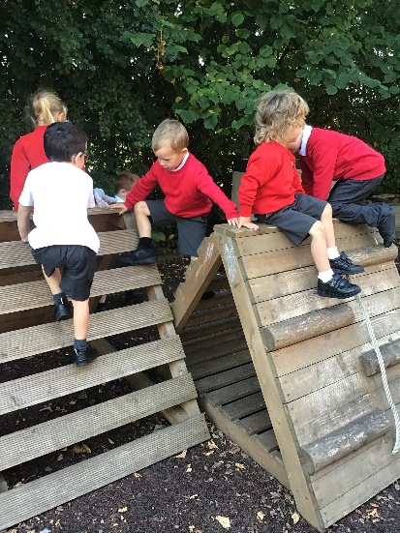
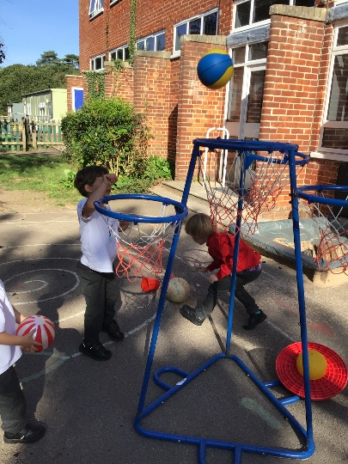
How do we develop gross motor skills?
We ensure that the children have opportunities to climb, roll, walk, run, skip, crawl, jump and hop.
We ensure they develop various skills such as ball skills, balance and co-ordination.
We ensure that they are able to collaborate and use their skills in team sports.
This not just through P.E lessons, but through ensuring that our environment both indoors and outdoors facilitates this.
We develop shoulder, elbow and wrist pivots to get them ready to write. We do this with Jedi writing, funky finger activities and dough gym.

Slide 17
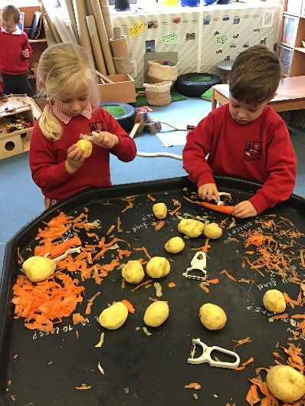
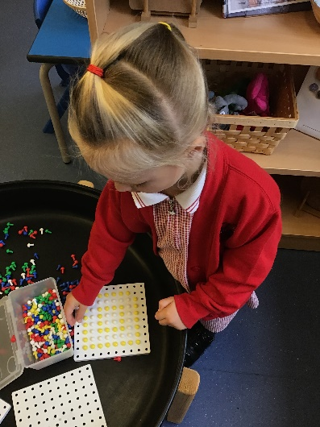
How do we develop fine motor skills?
We give children the opportunity to use a variety of small tools such as scissors, cutlery, paintbrushes, tweezers and more.
We have daily ‘Funky Finger’ sessions- they carry out exercises designed to develop their muscles and get them ready for writing.
Playdough is always available to help develop skills such as squeezing, pinching, pulling, and rolling.
We write at every given opportunity- through their play we find ways to make writing fun and meaningful.
Through these activities we help to develop their pencil grip- which is key to develop effective writing.

Slide 18
Thank you for listening!

