Slide 1
Early Years
Writing and Maths
Virtual Meetings
Please put your name and your child’s first name and year group in the chat bar.
If you have any questions please write them in the chat bar and we will answer as many of these as possible at the end of the session. If we have questions outstanding, we will do a FAQ page and send this out.
Due to Zoom timing restraints, this meeting will cut off after 40 minutes.

Slide 2
Getting Ready to Write
Being ready to write is fundamentally important. This means we need to understand the physical development that happens before we are expecting children to pick up a pencil and produce letters.
“Fine motor control and precision helps with hand-eye co-ordination which is later linked to early literacy. Repeated and varied opportunities to explore and play with small world activities, puzzles, arts and crafts and the practise of using small tools, with feedback and support from adults, allow children to develop proficiency, control and confidence.” (The Educational Programs EYFS 2020)

Slide 3
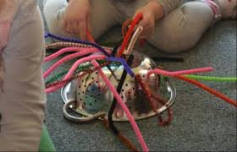
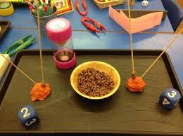
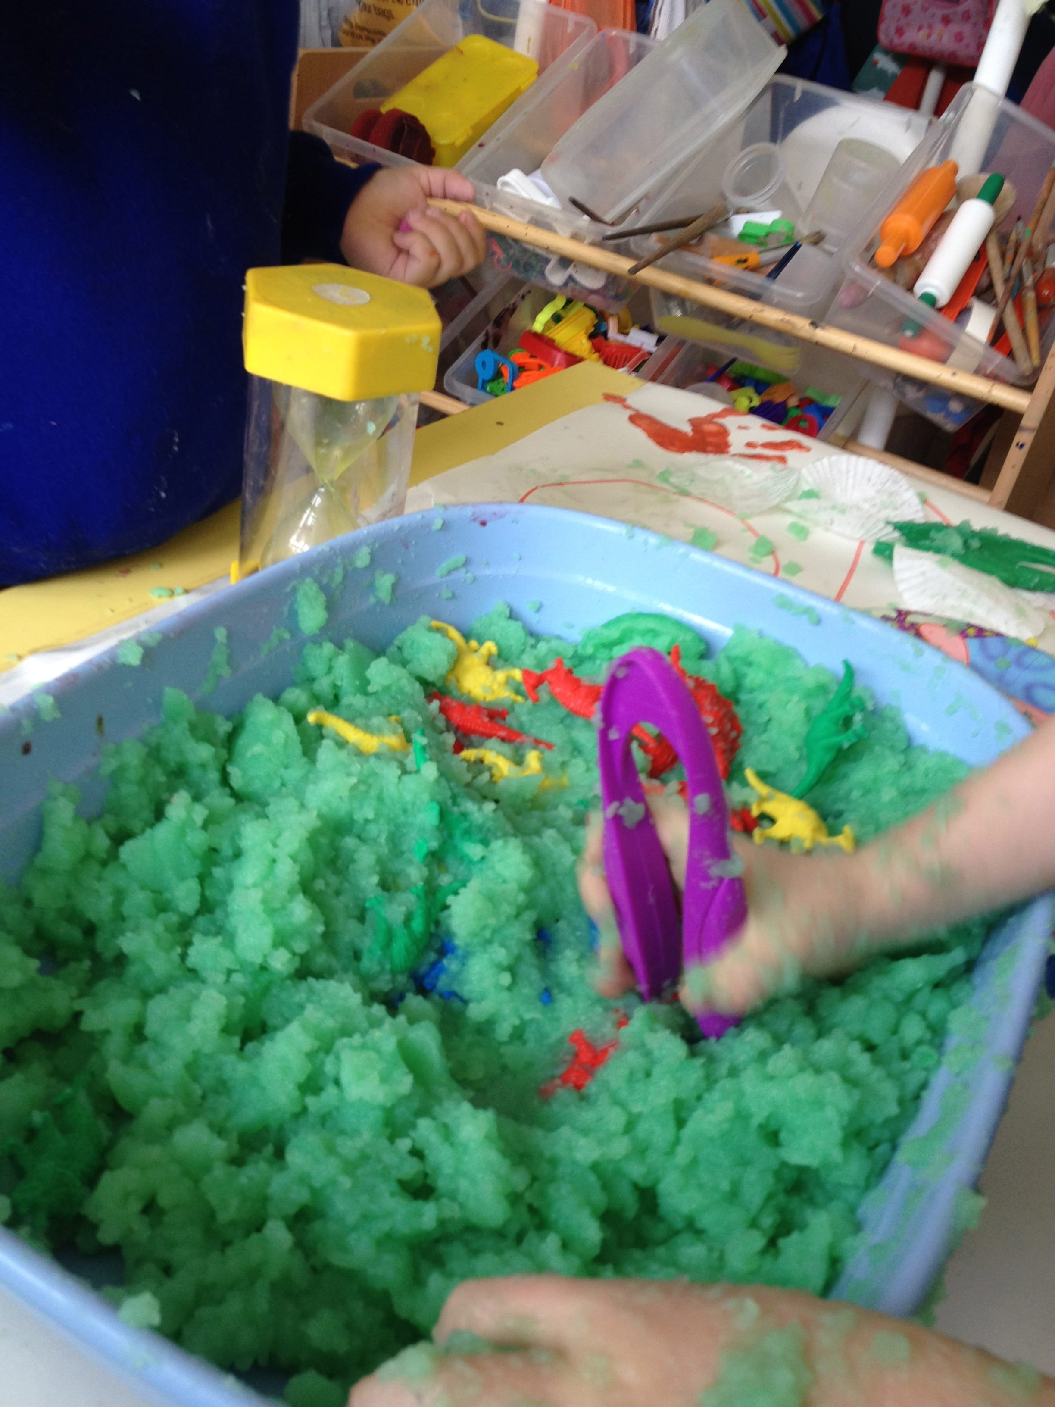
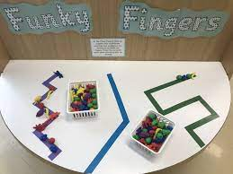
Funky Fingers
We have daily Funky Finger sessions, where we provide opportunities for the children to develop their gross and fine motor skills in preparation to become fluent writers.

Slide 4
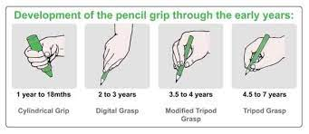
Pencil Grip
Ensuring that children are holding their pencil using the correct grip is very important as they develop through the early years.
To be able to form letters correctly and then move on to develop their handwriting, they need to be able to hold their pencil the correct way.

Slide 5
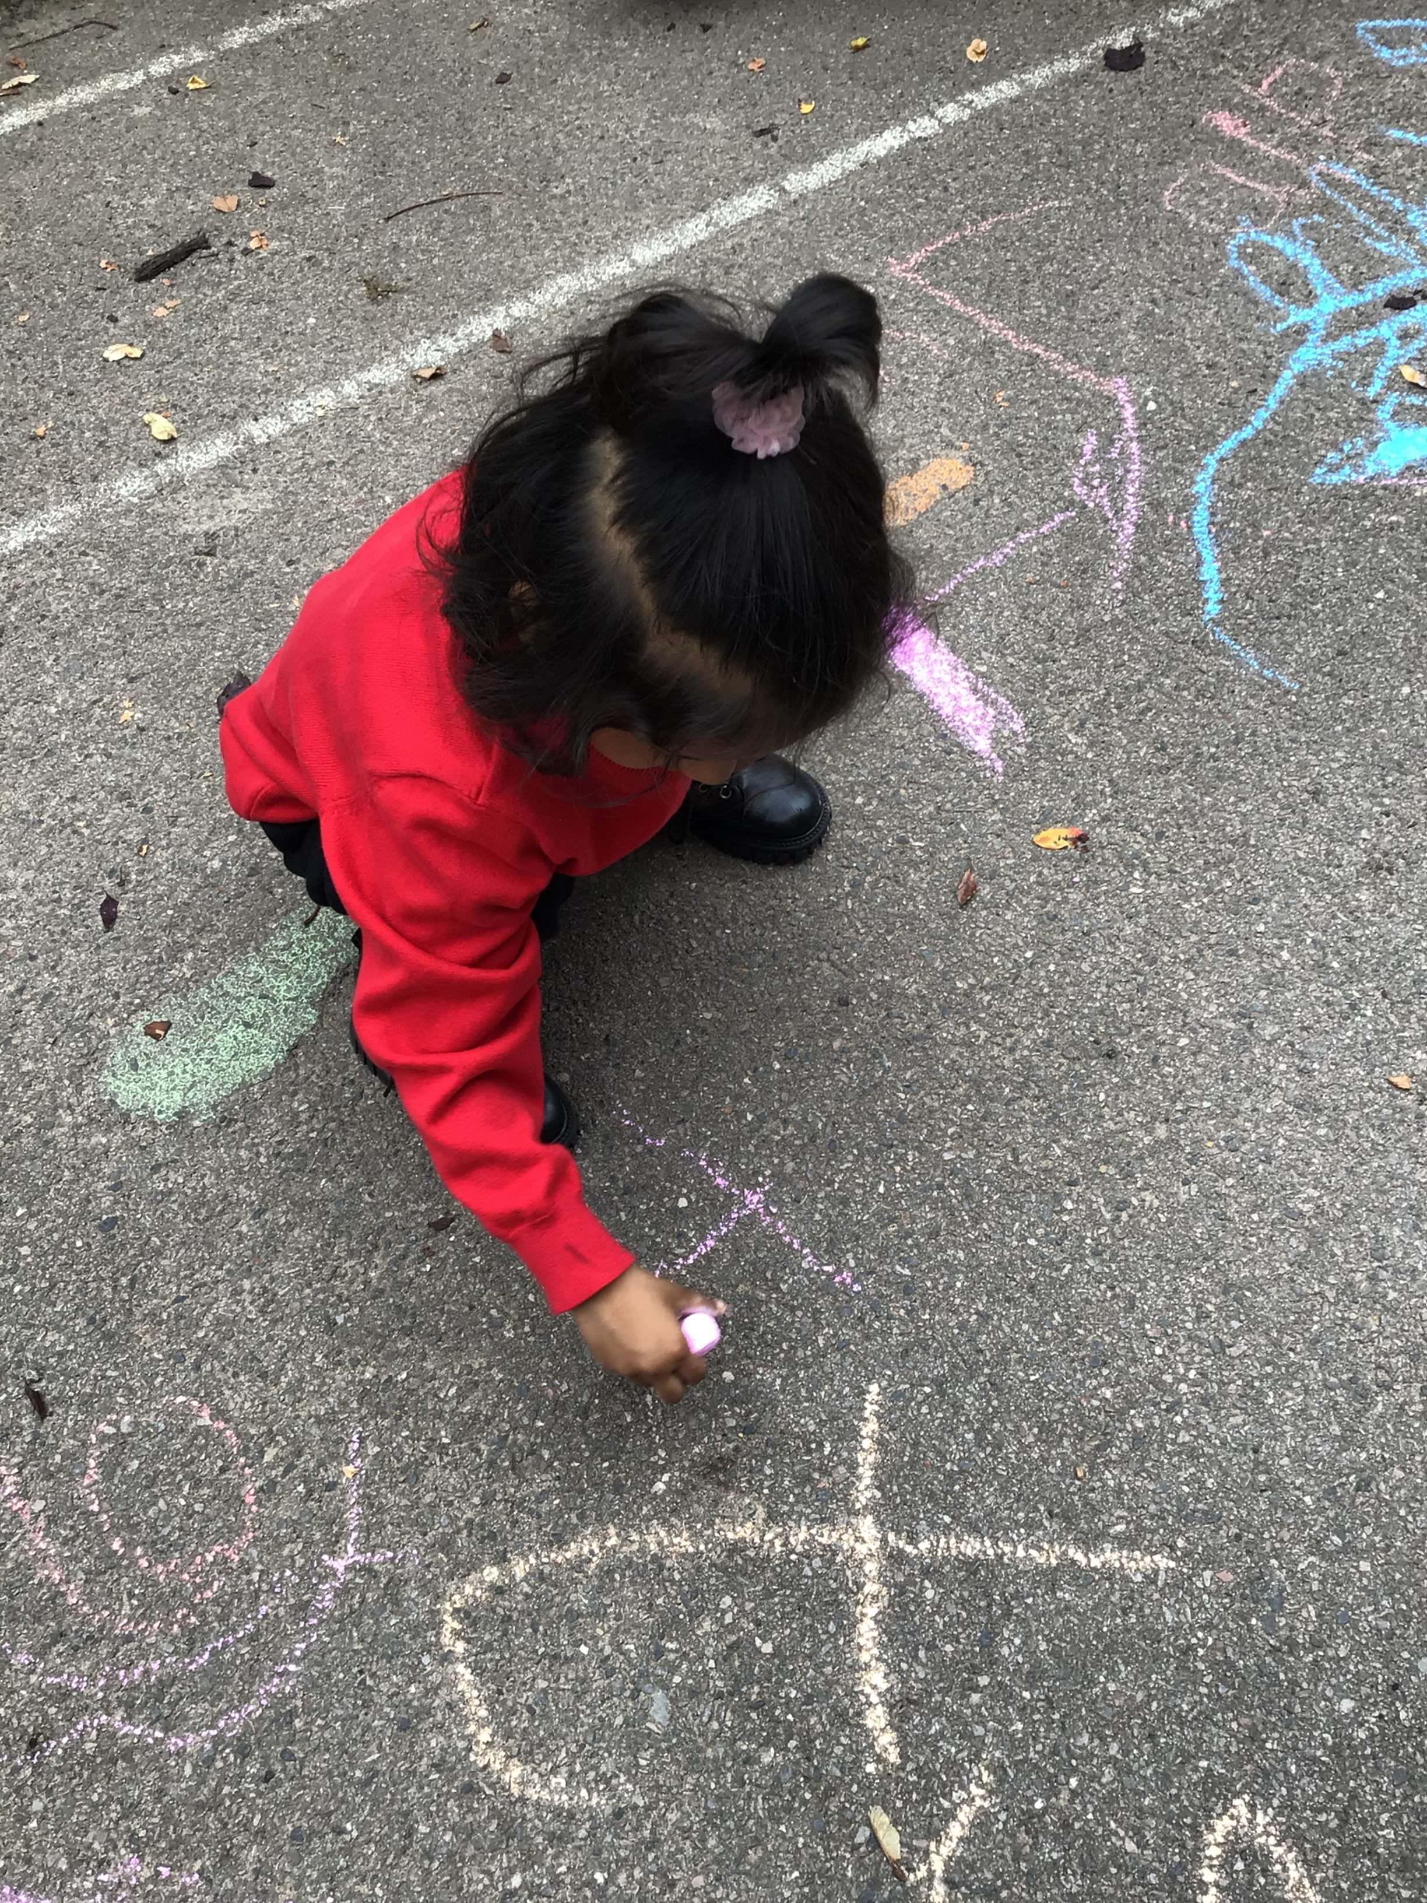
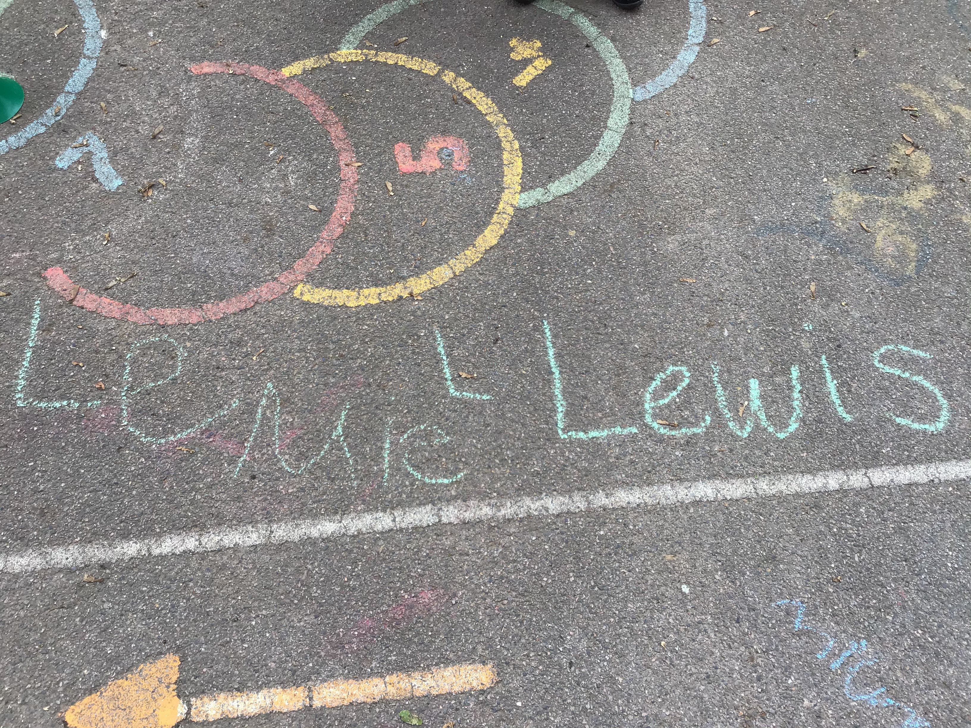
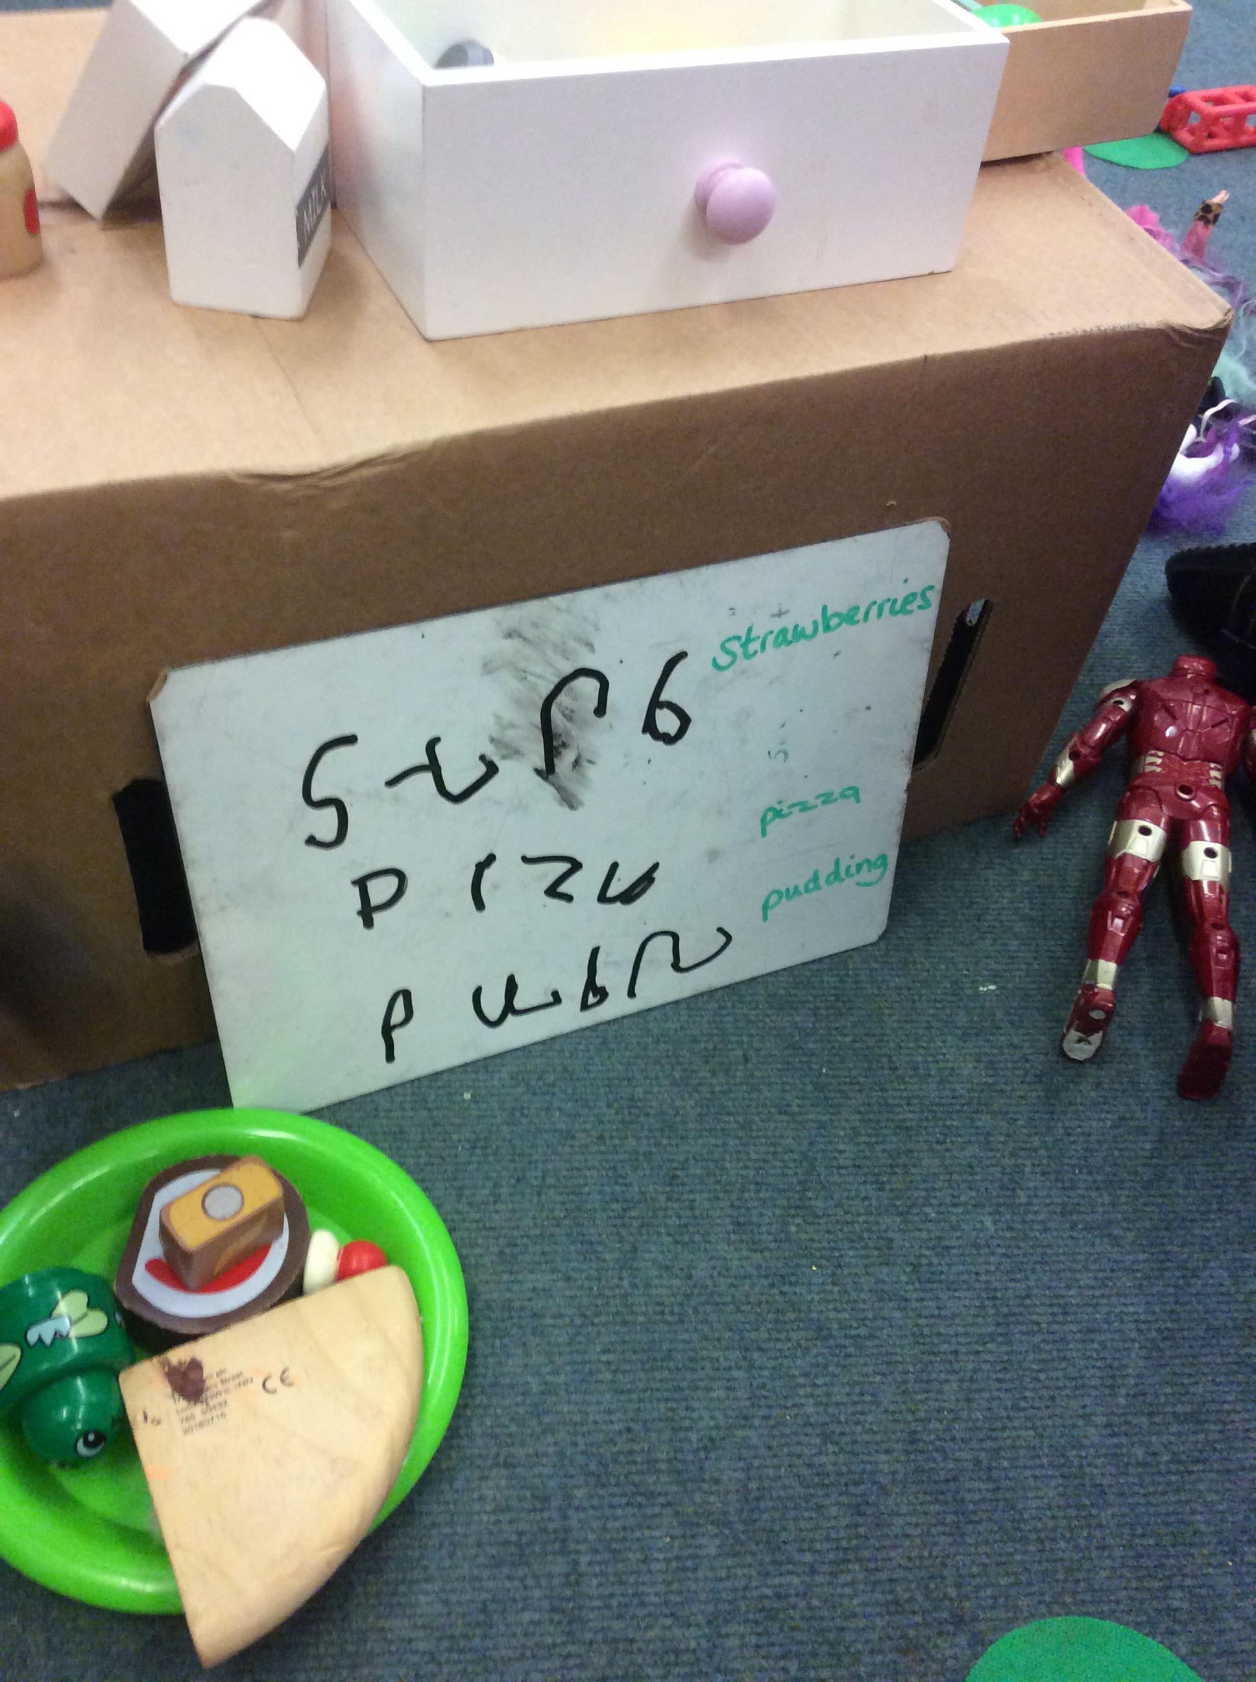
Opportunities Within Our Learning Environment
We have a writing rich learning environment, which means that we have opportunities to
develop children’s independence in writing within their play. We create activities to continue
developing their physical readiness. We continually build on the knowledge taught within
phonics and teach them to apply this to their ‘real world’ experiences.

Slide 6
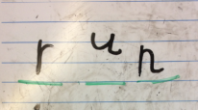
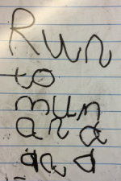
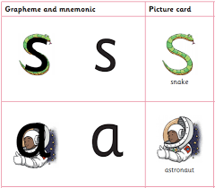
Letter Formation and Spelling
ELG
• Write recognisable letters, most of which are correctly formed.
• Spell words by identifying sounds in them and representing the sounds with a letter or letters.
• Write simple phrases and sentences that can be read by others.
To teach the correct letter formation we follow the Little Wandle program- they use captions that help guide the children. These can be found on the Little Wandle website and as a handout.
Spellings are taught during our phonics sessions using the graphemes that children are revising and tricky words that have been taught.

Slide 7
English Curriculum
On our website you can find our English Curriculum, end of year expectations and our spelling policy.

Slide 8
Little Wandle for parents
Within the EYFS section you can find a direct link to Little Wandle and the letter formation support.

Slide 9
Maths

Slide 10
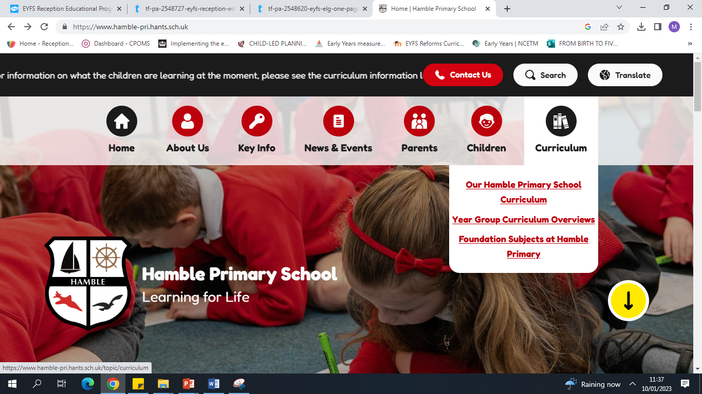
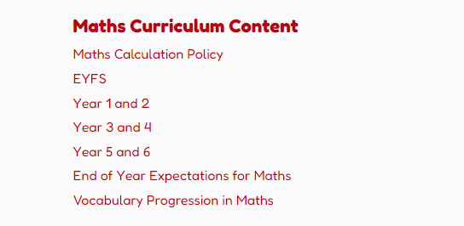
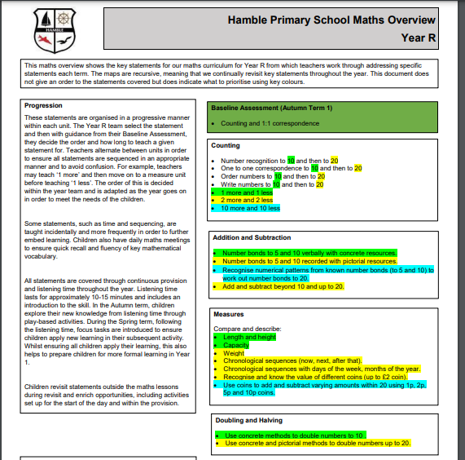
Maths Curriculum
On the schools website you will find our curriculum.
In this section you will find our maths calculation policy
And the EYFS curriculum content.

Slide 11
Early Learning Goal
Number- Have a deep understanding of number to 10, including the composition of each number. • Subitise (recognise quantities without counting) up to 5. • Automatically recall (without reference to rhymes, counting or other aids) number bonds up to 5 (including subtraction facts) and some number bonds to 10, including double facts.
Numerical Patterns- Verbally count beyond 20, recognising the pattern of the counting system. • Compare quantities up to 10 in different contexts, recognising when one quantity is greater than, less than or the same as the other quantity. • Explore and represent patterns within numbers up to 10, including evens and odds, double facts and how quantities can be distributed equally

Slide 12
Maths Meeting
Recognition of numbers.
Children learn and remember numbers by sight.
Children interact and support each other by playing games.

Slide 13
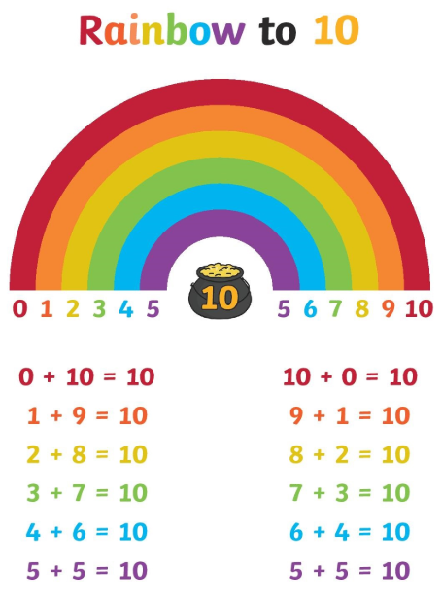
Number bonds
What is a number bond?
Why are these important?
Why these are useful further
up the school.

Slide 14
Why are number bonds important?
7 + 3 = 10
Knowing the number fact 7+3 off the top of your head means that you would have no problem calculating 70+30 because you know that the answer must be 10 but with one more zero on the end = 100.
You understand this because you already know that 7+3 is 10 and you understand basic place value and this is why children need to know them.

Slide 16
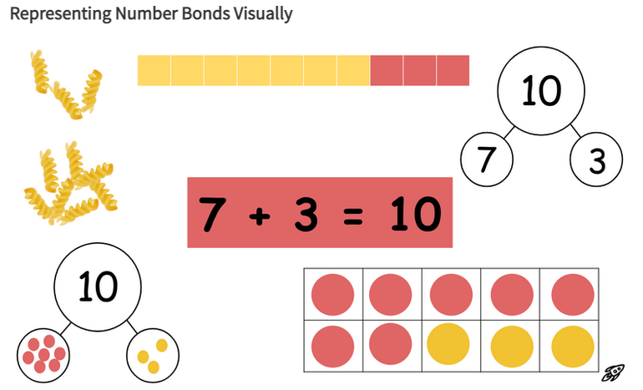
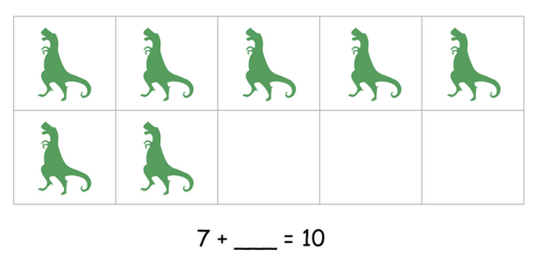
Children are shown different ways of representing numbers so that they can eventually draw them independently to solve a problem. In the meantime, they might be asked to complete unfinished pictures and then fill in the missing corresponding number.

Slide 17
Maths at home
How did you find maths at school? Did you enjoy it? Loathe it? It is really important to always try to BE POSITIVE as this will greatly influence your child’s relationship with their learning.
Maths talk is really important in developing children’s confidence with number and shape and to them becoming successful mathematicians.

Slide 18
Maths at home
At home, engage children in conversation such as getting them involved with the cooking and measuring or even by counting.
Play board games together, or games involving maths such as what’s the time Mr Wolf.
Lots of parks now have shapes and games for you to engage in together.
Spot numbers when out and about- on buses, houses, and prices.

Slide 19
Thank you for listening!
If you have any questions, please do not hesitate to ask me.

